Slide 1
Integrating Body and Spirit as Portal to Connectivity and Belonging
Dr. Laura Katz Rizzo
NIAS Conference, “Belonging and Mobility”
Friday, October 20, 2023

Slide 2
The thought manifests as the word;
The word manifests as the deed;
The deed develops into habit;
The habit hardens into character.
As the shadow follows the body,
As we think, so we become.
Dhammapada (in Anderson 2012 131)

Slide 3
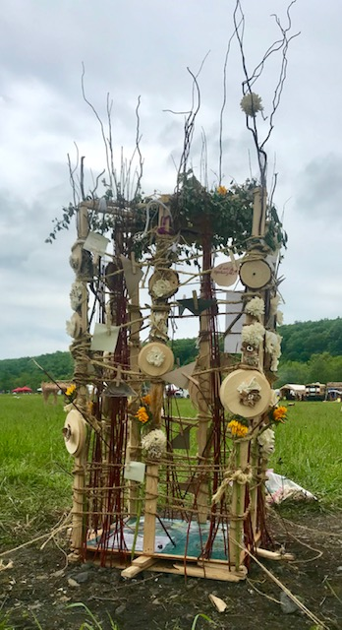
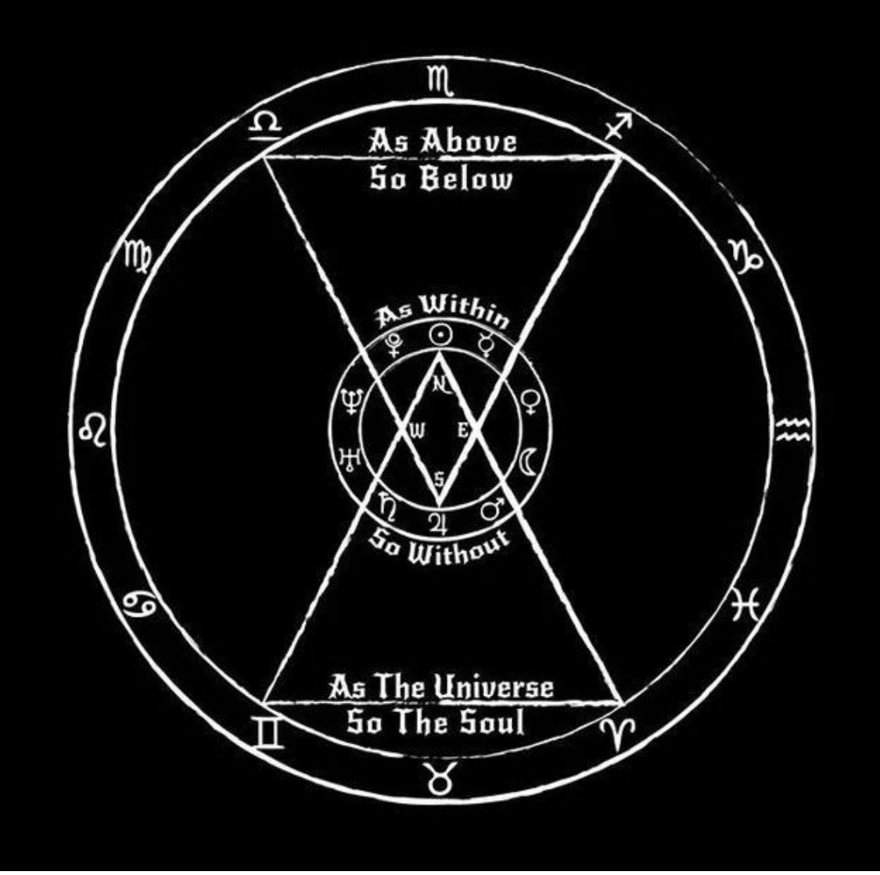

Slide 4
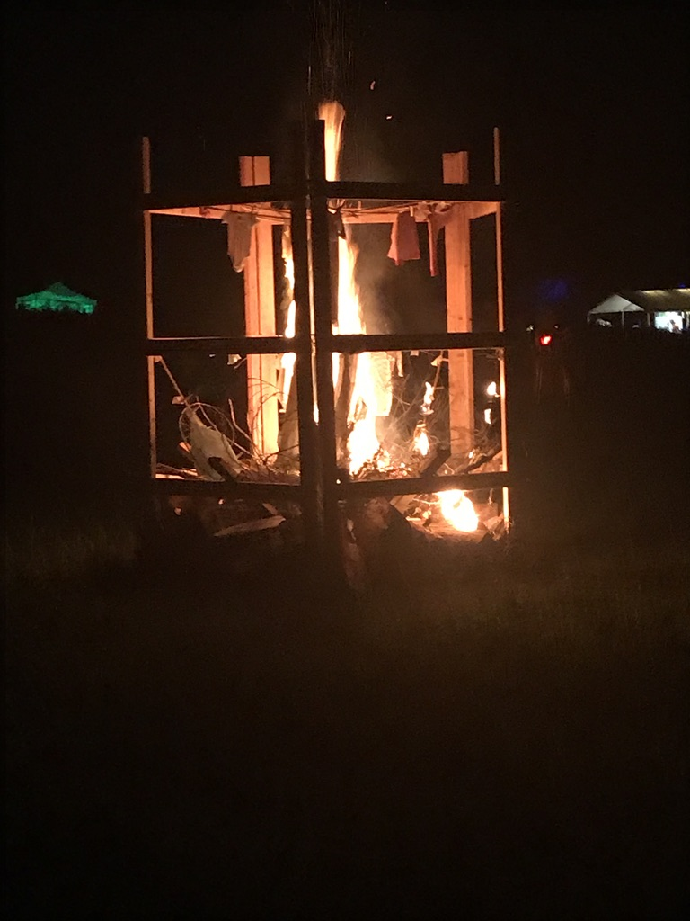
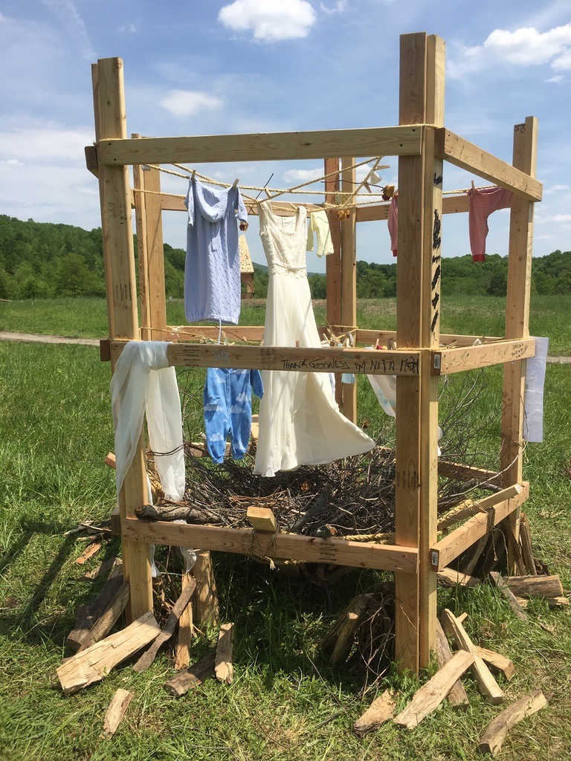

Slide 5
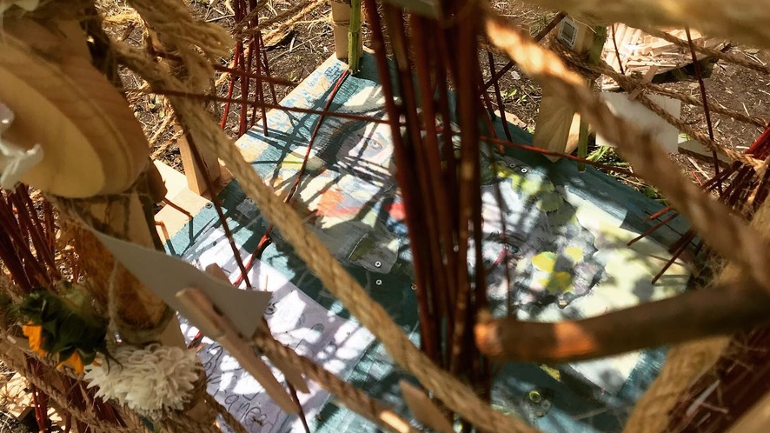

Slide 6
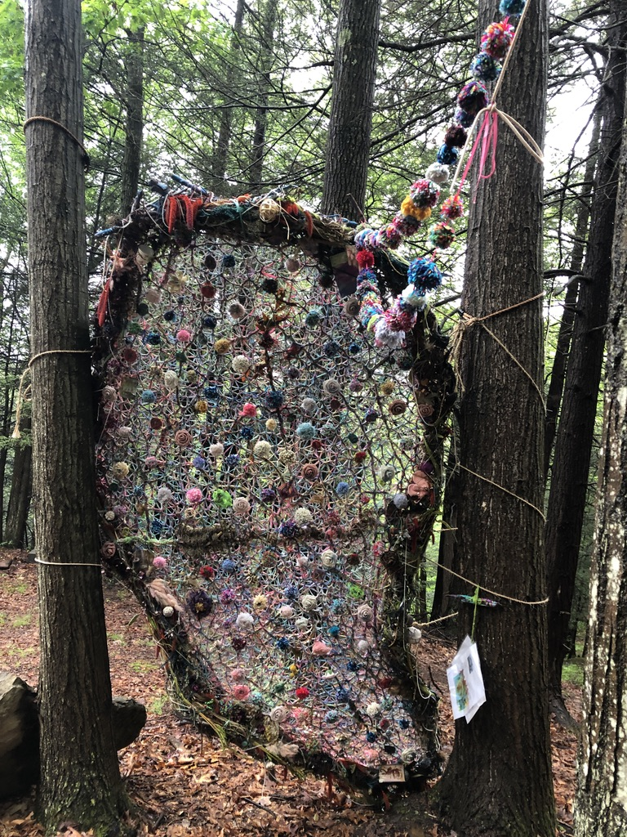
The Net of Indra is a profound and subtle metaphor for the structure of reality. Imagine a vast net; at each crossing point there is a jewel; each jewel is perfectly clear and reflects all the other jewels in the net, the way two mirrors placed opposite each other will reflect an image ad infinitum. The jewel in this metaphor stands for an individual being, or an individual consciousness, or a cell or an atom. Every jewel is intimately connected with all other jewels in the universe, and a change in one jewel means a change, however slight, in every other jewel.”-The Enlightened Mind, by Stephen Mitchell

Slide 10
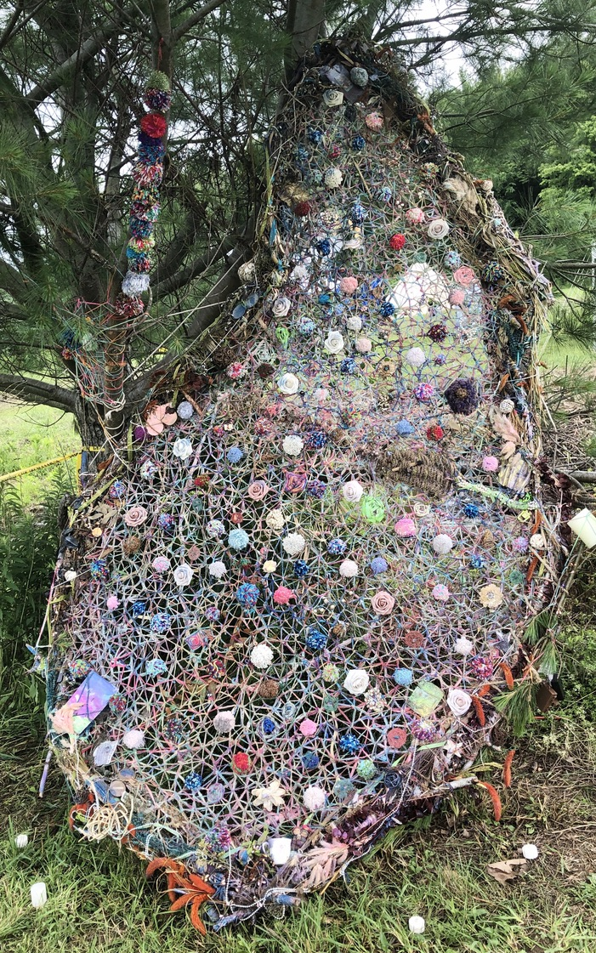
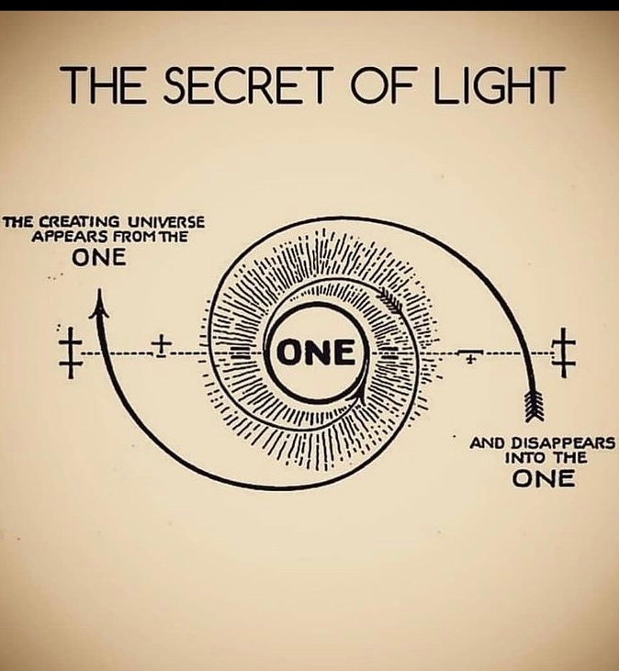

Slide 11
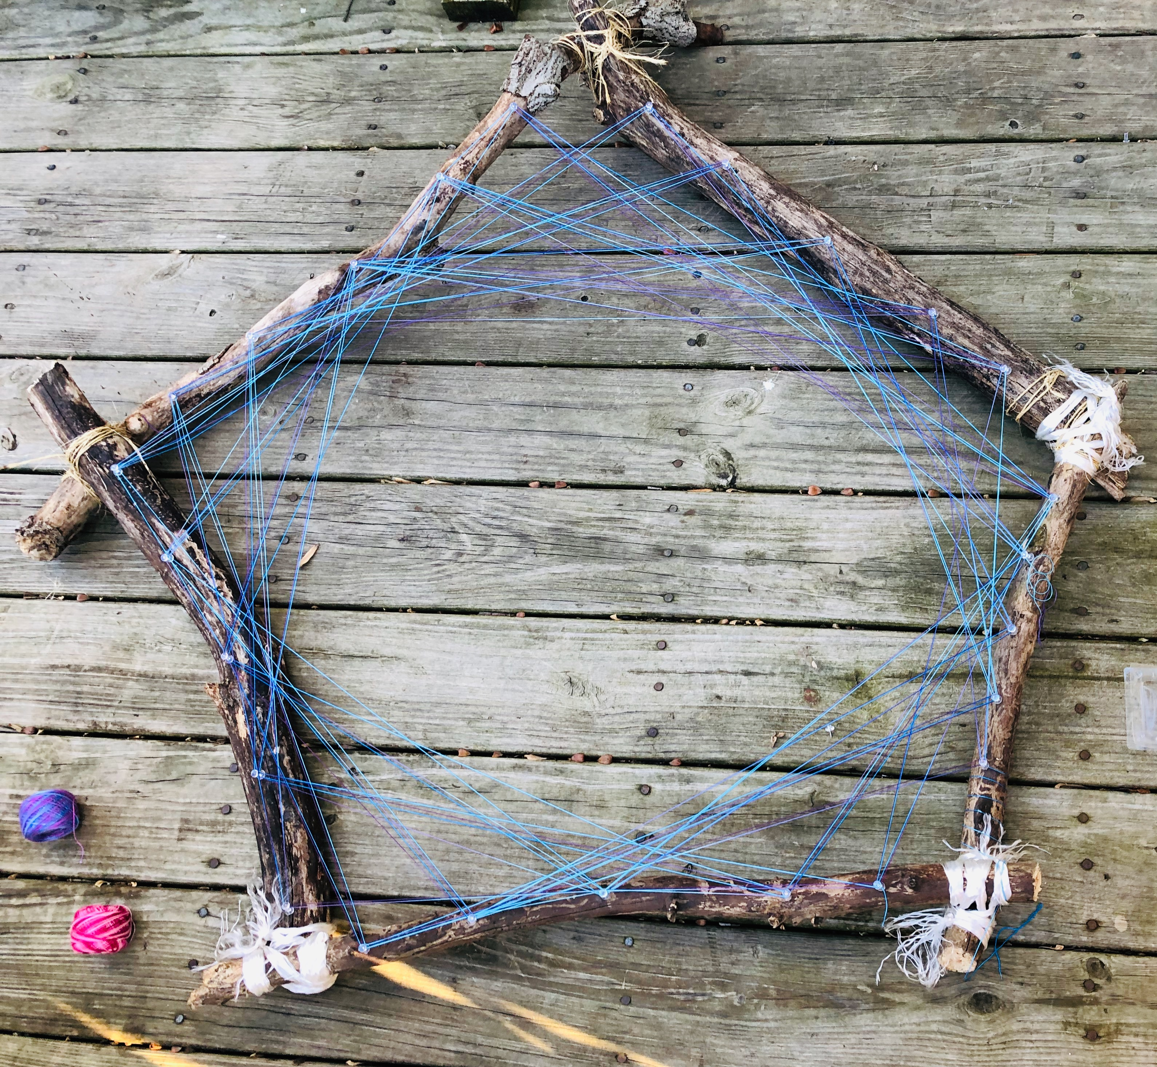

Slide 12
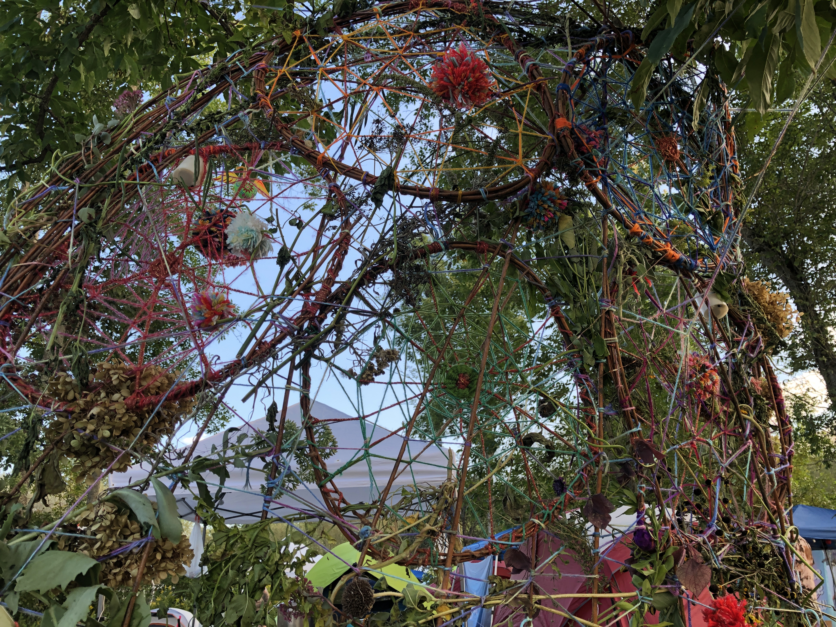

Slide 13
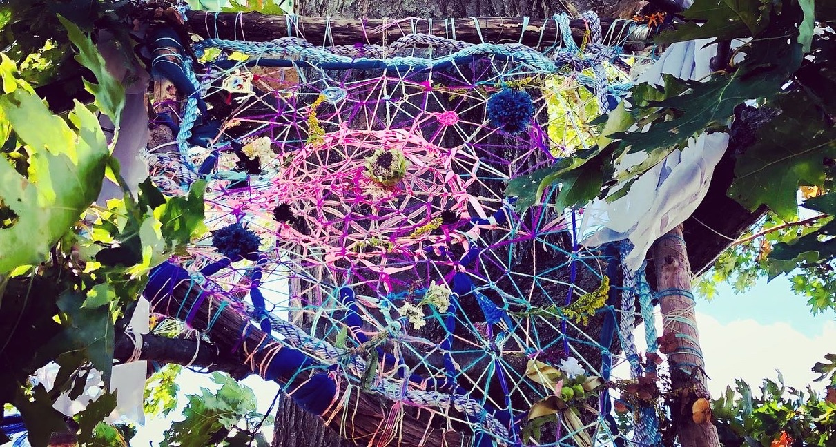

Slide 14
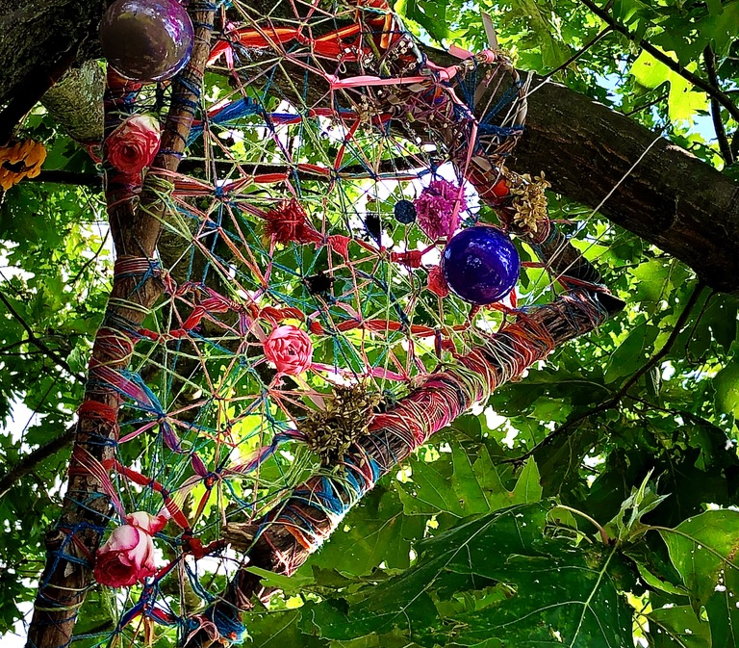
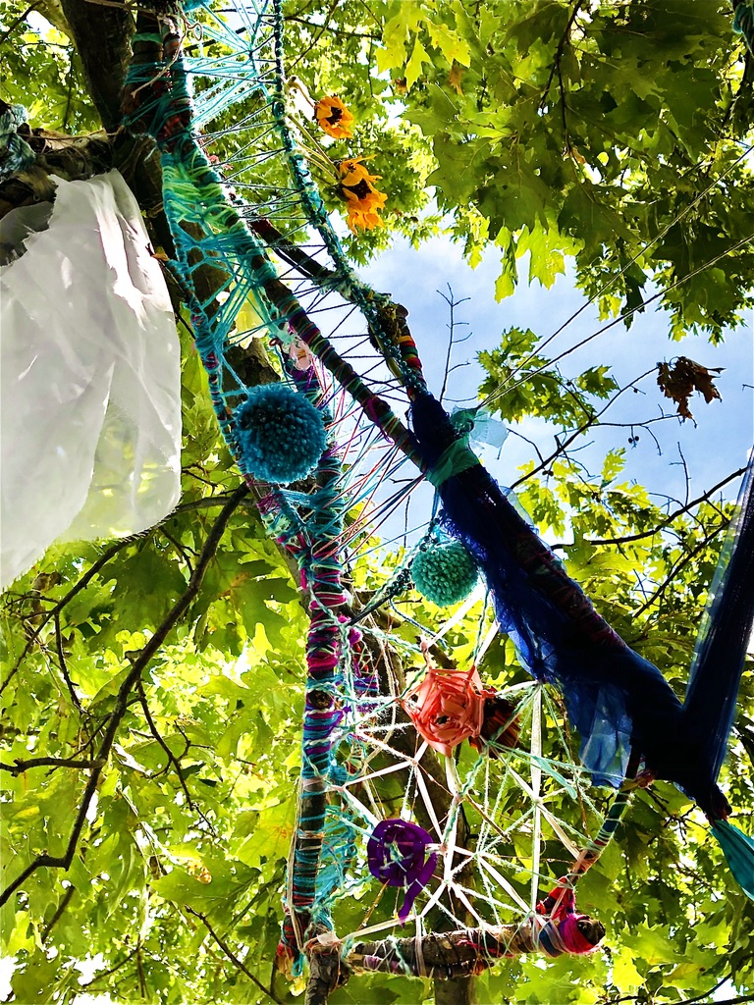

Slide 15
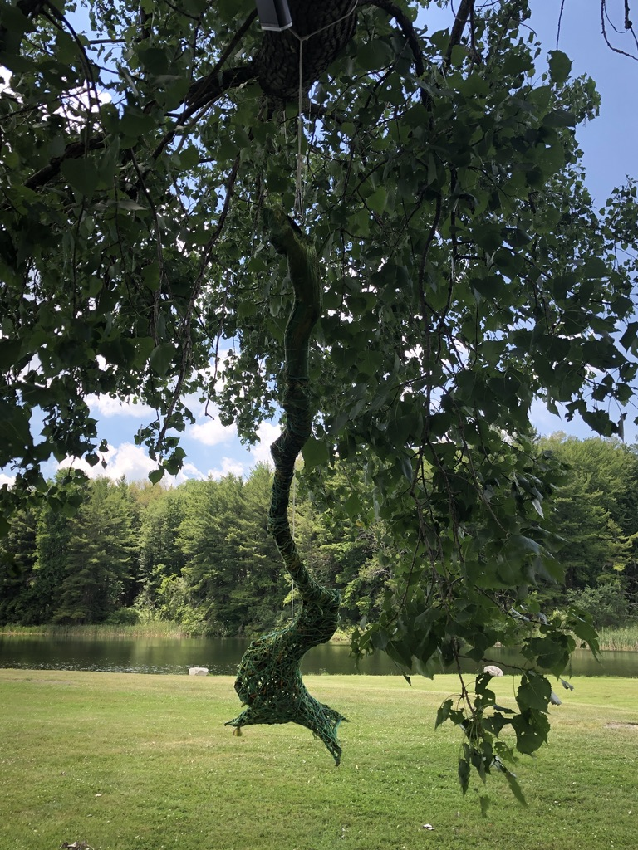
Ecognosis is like a knowing that knows itself. Knowing in a loop; a weird knowing. Weird from the Old Norse, urth, meaning twisted, in a loop.The less well-known noun weird means destiny or magical power, and by extension the wielders of that power, the Fates or Norns. In this sense weird is connected with worth, not the noun but the verb, which has to do with happening or becoming.
Tim Morton, Dark Ecology

Slide 16
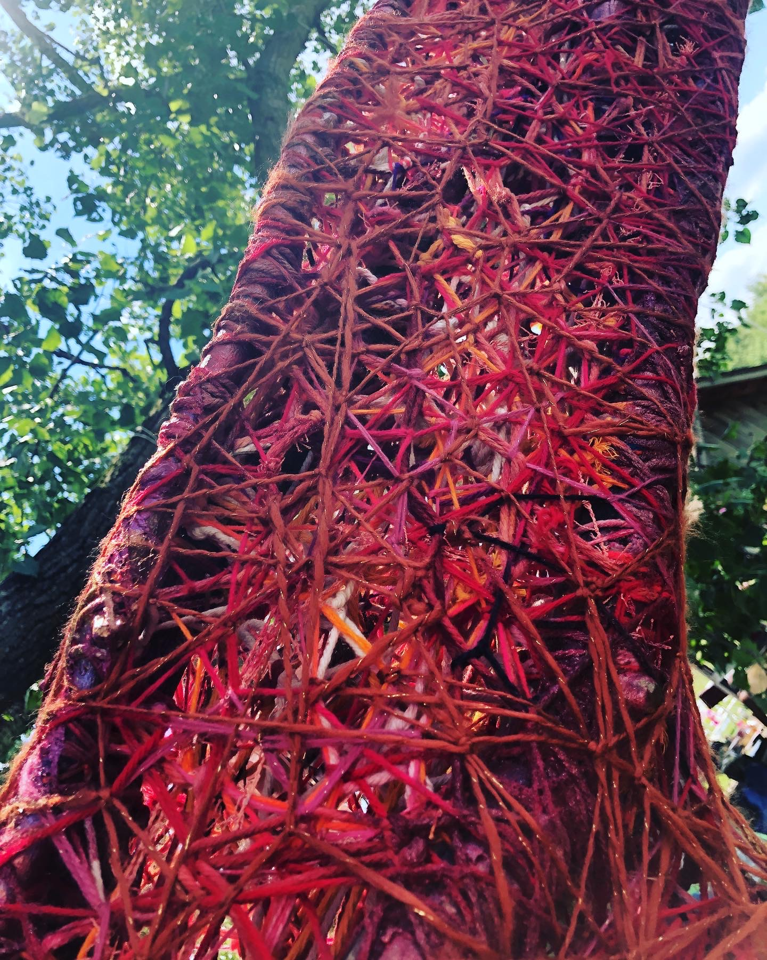
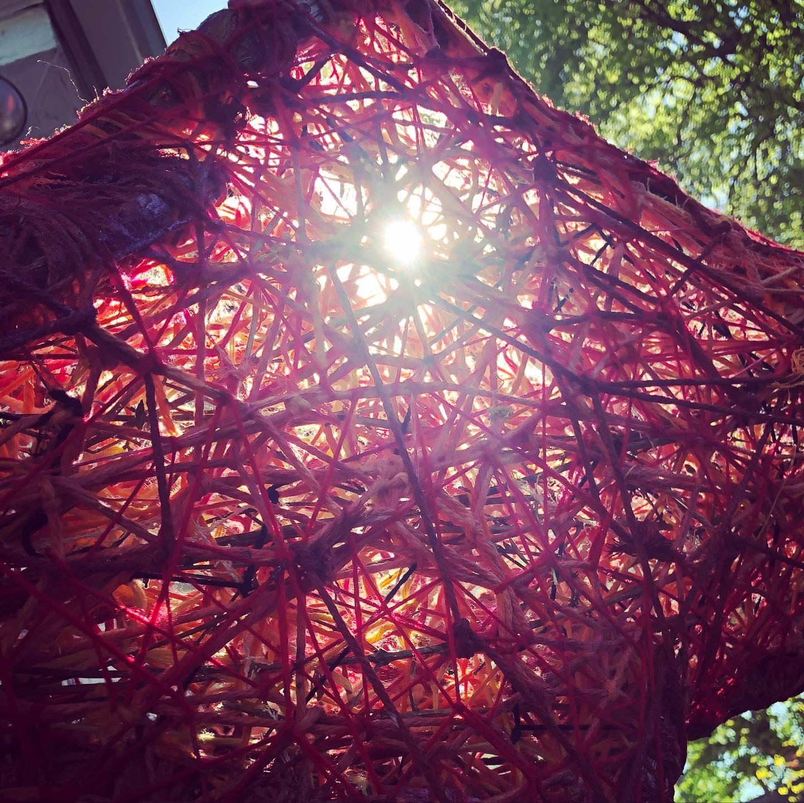

Slide 17
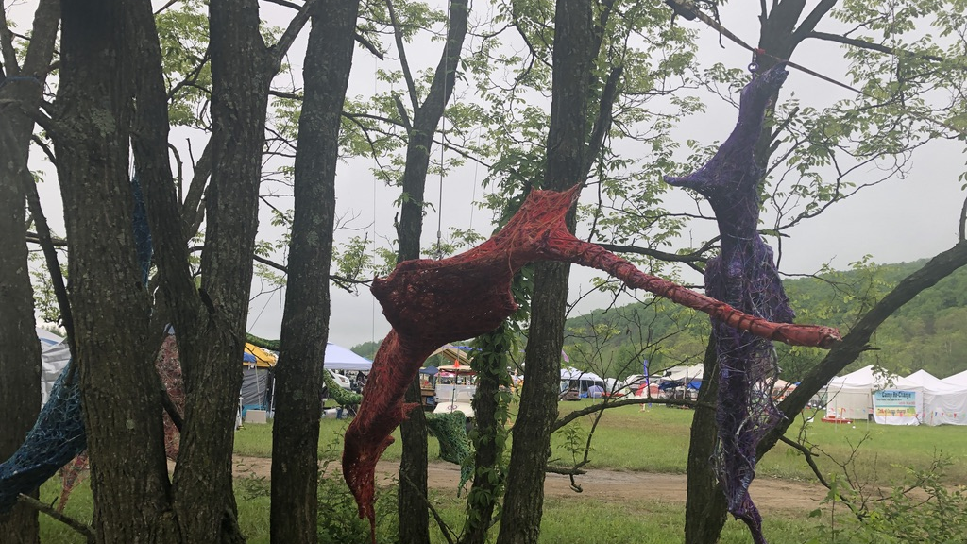

Slide 18
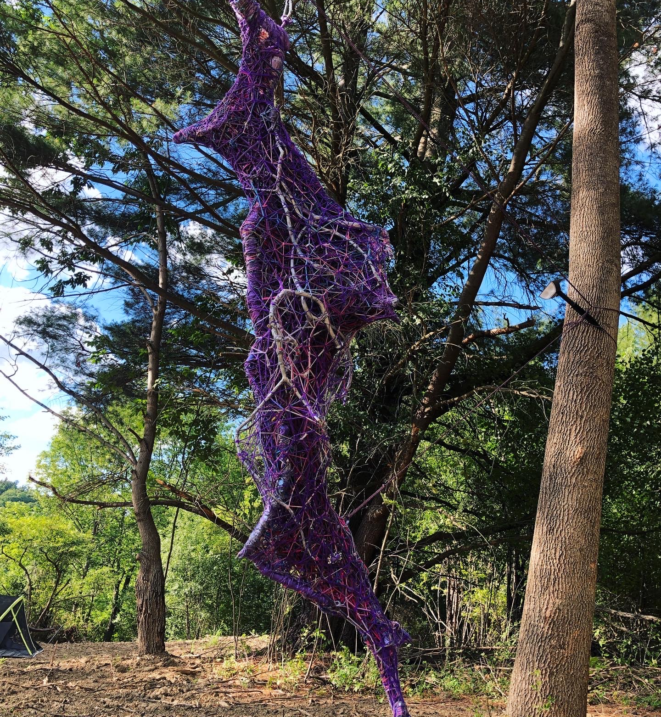
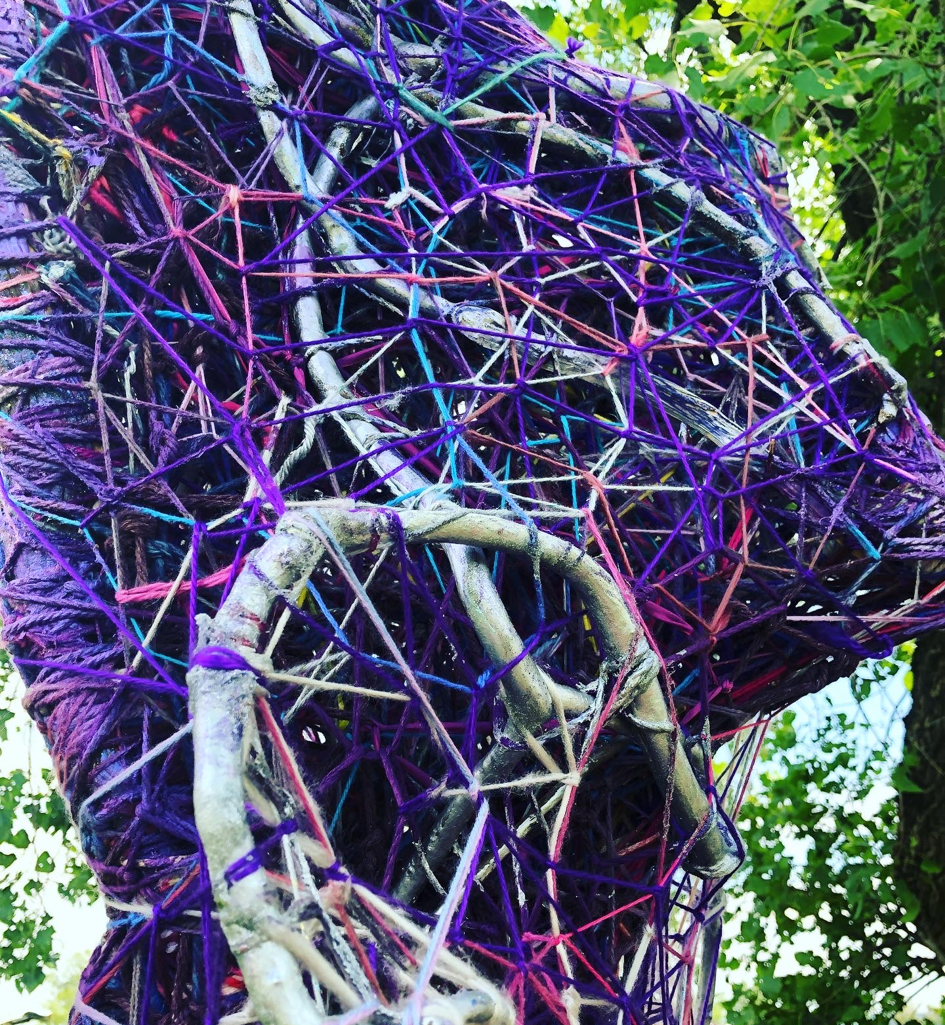

Slide 19
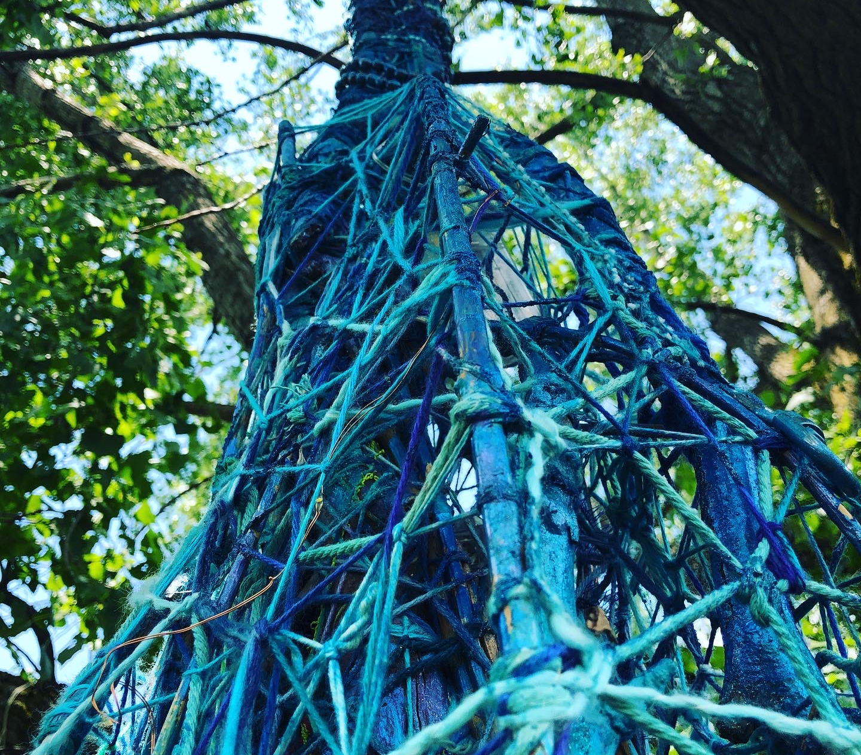
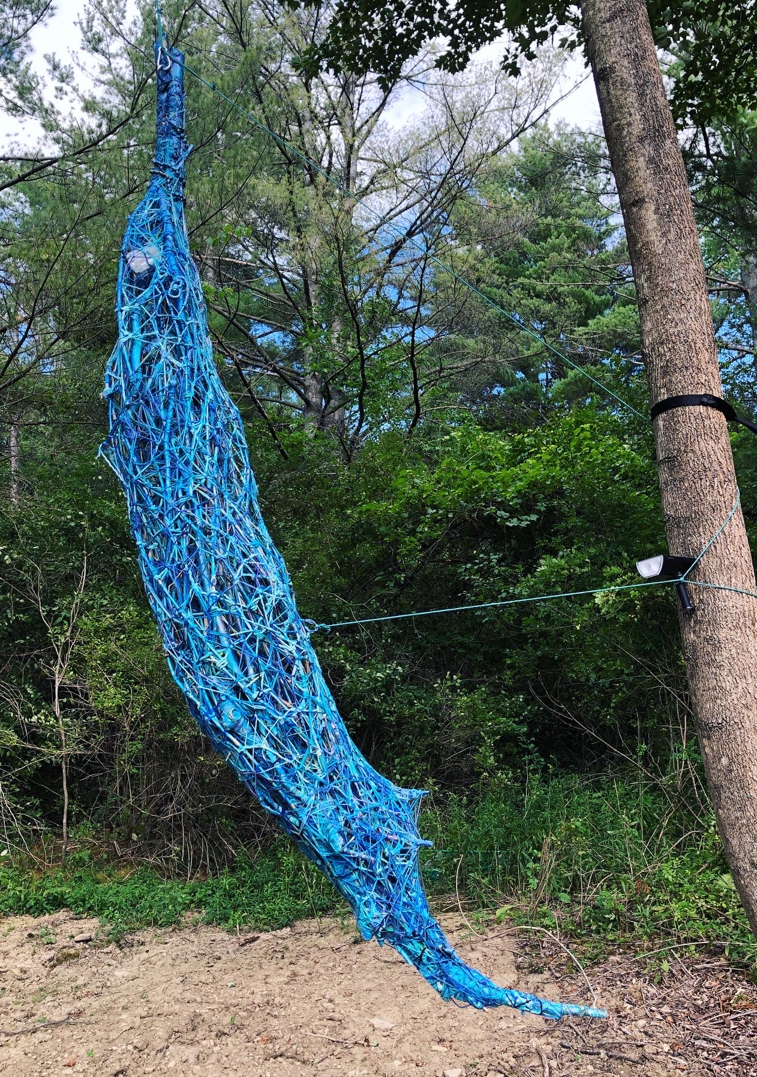

Slide 20
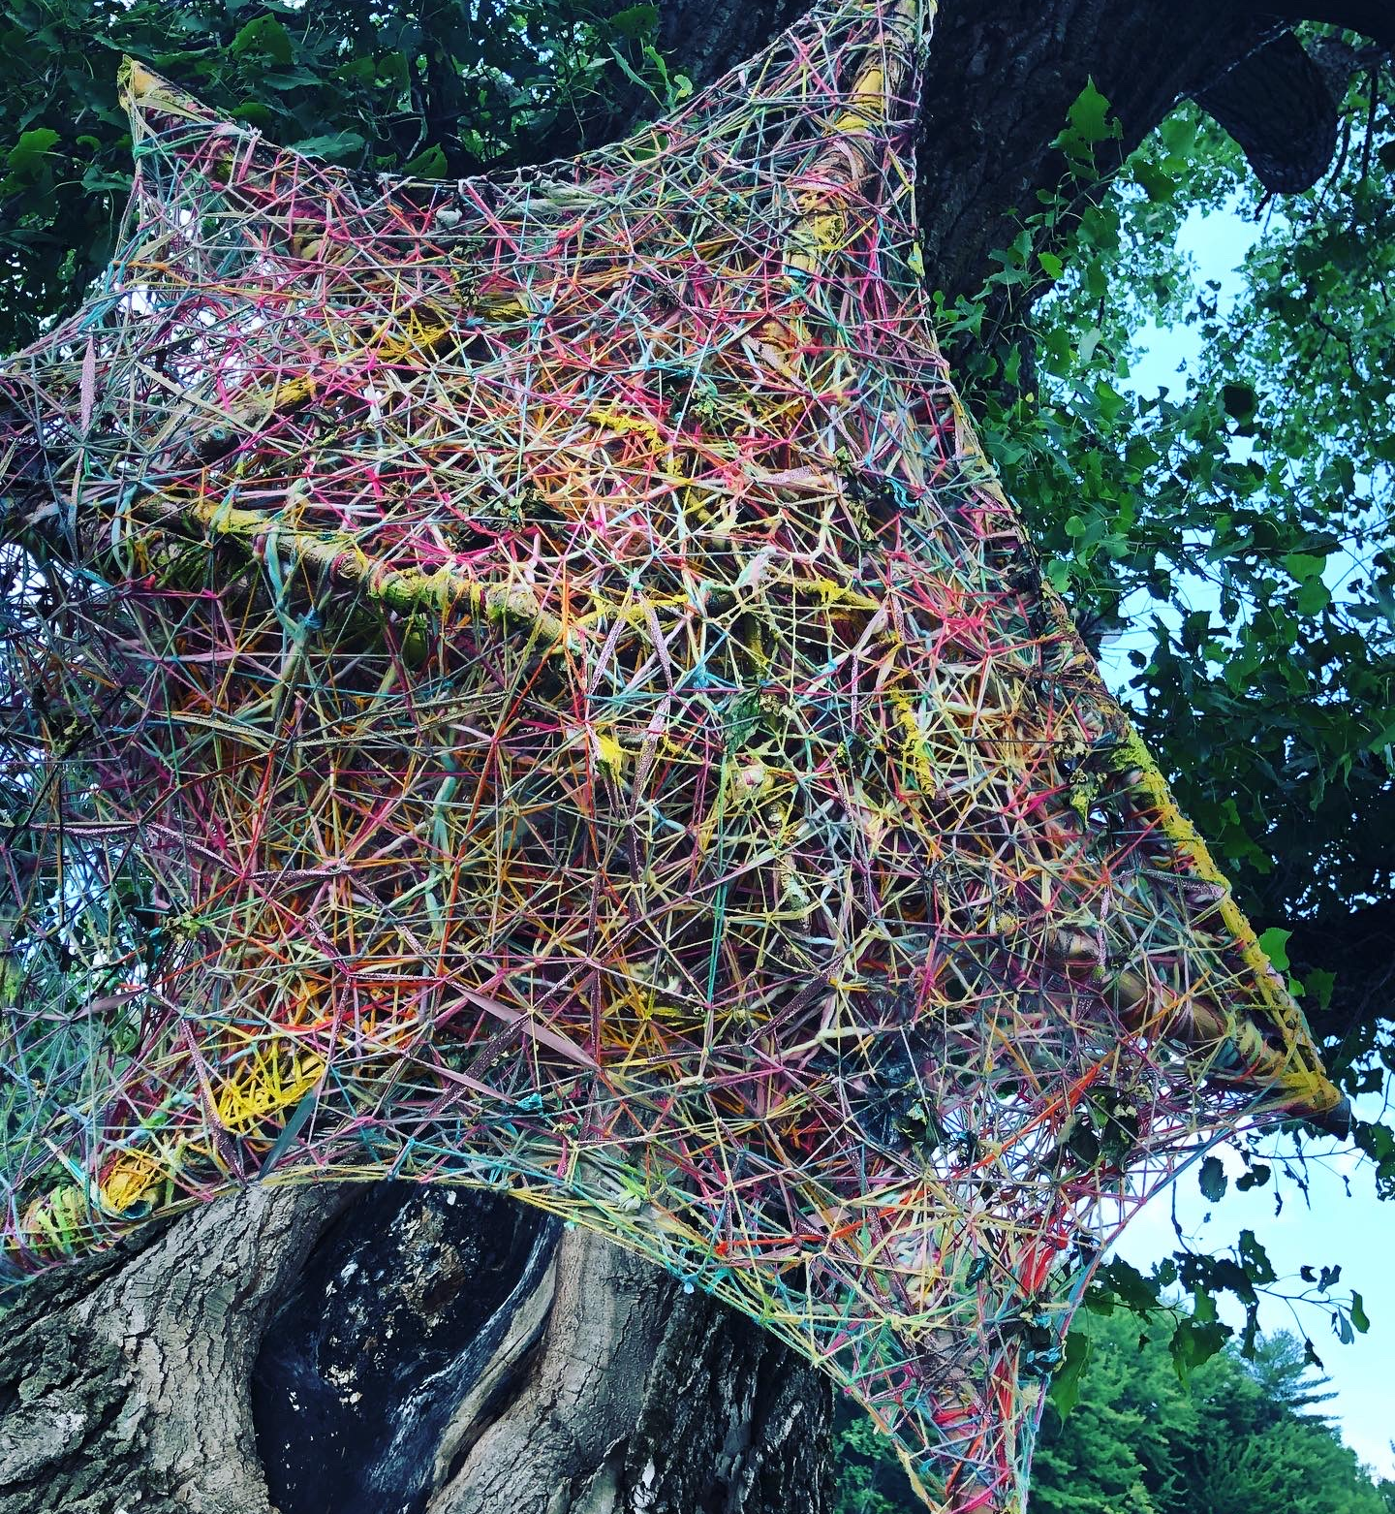
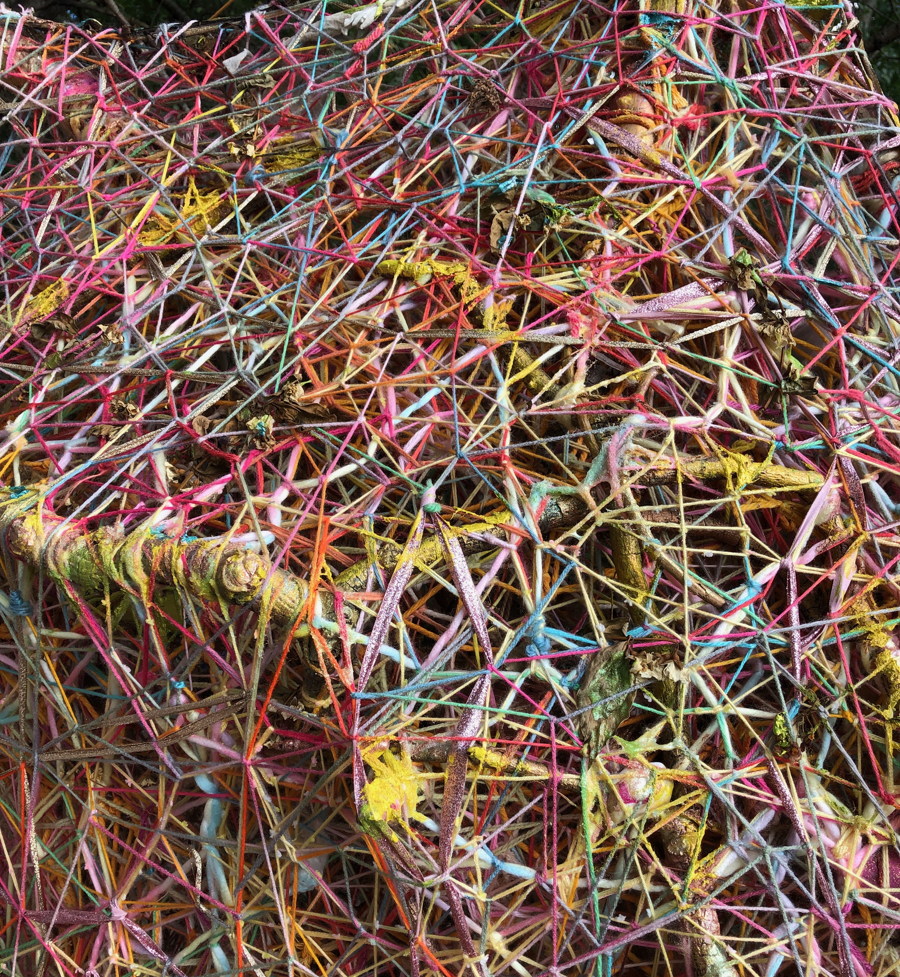

Slide 22
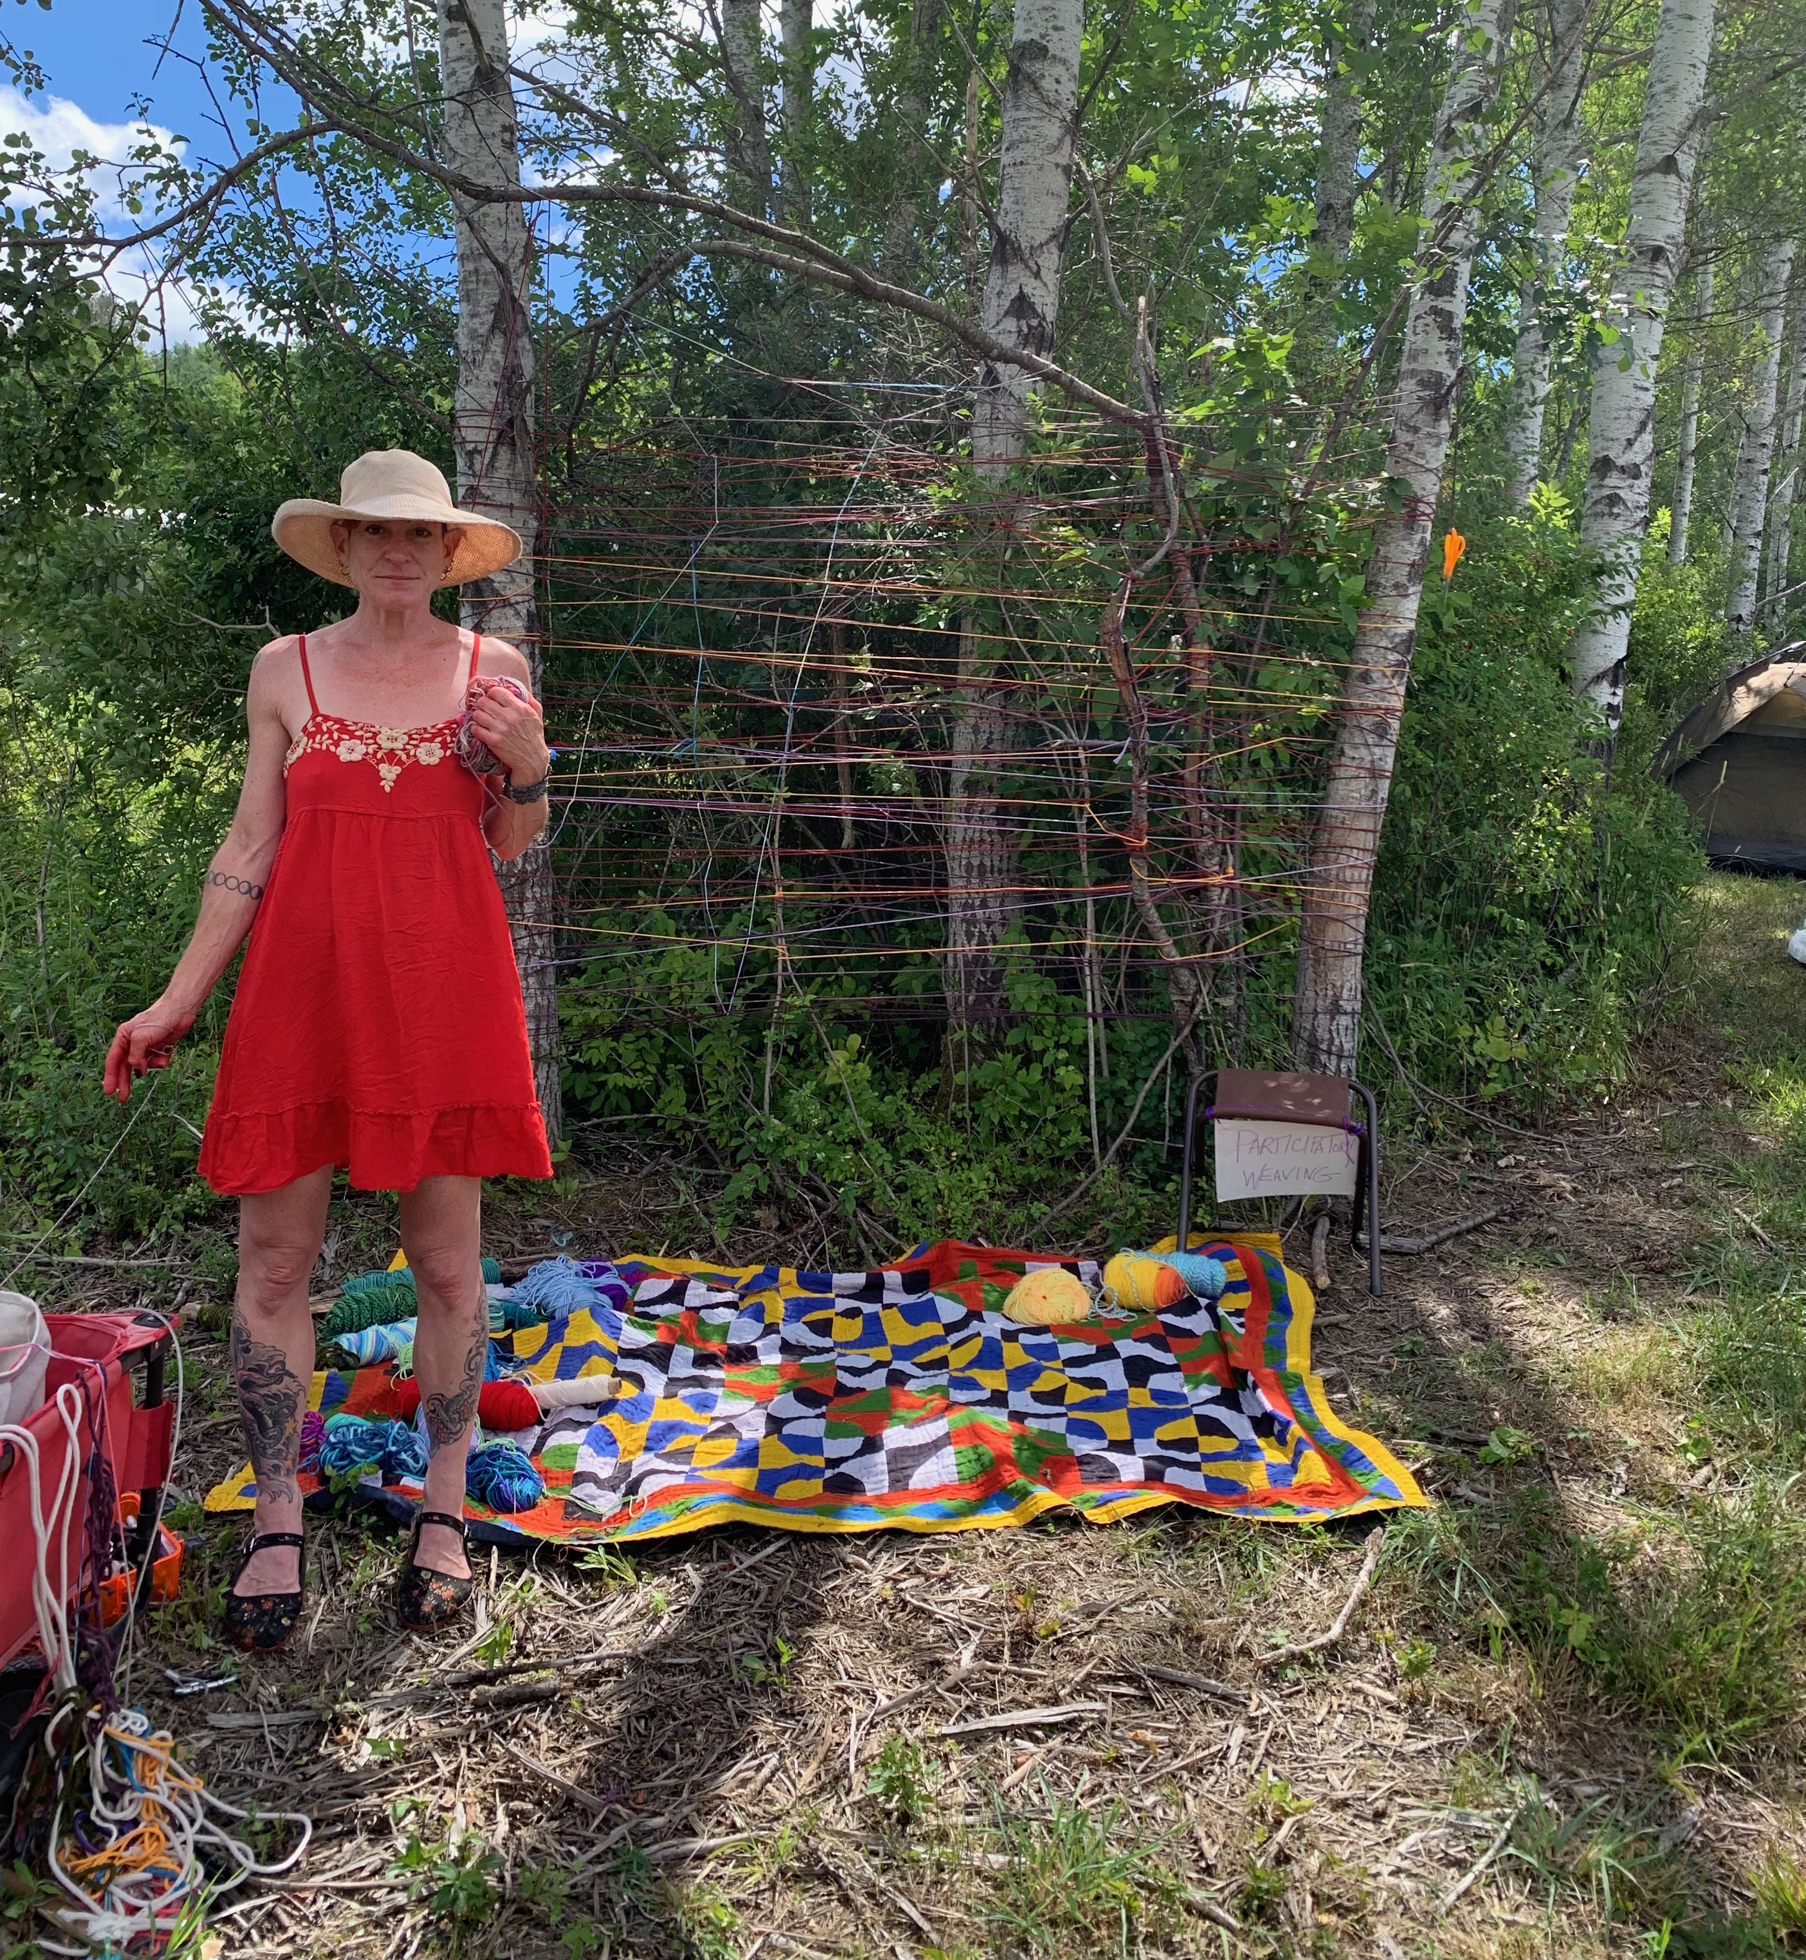
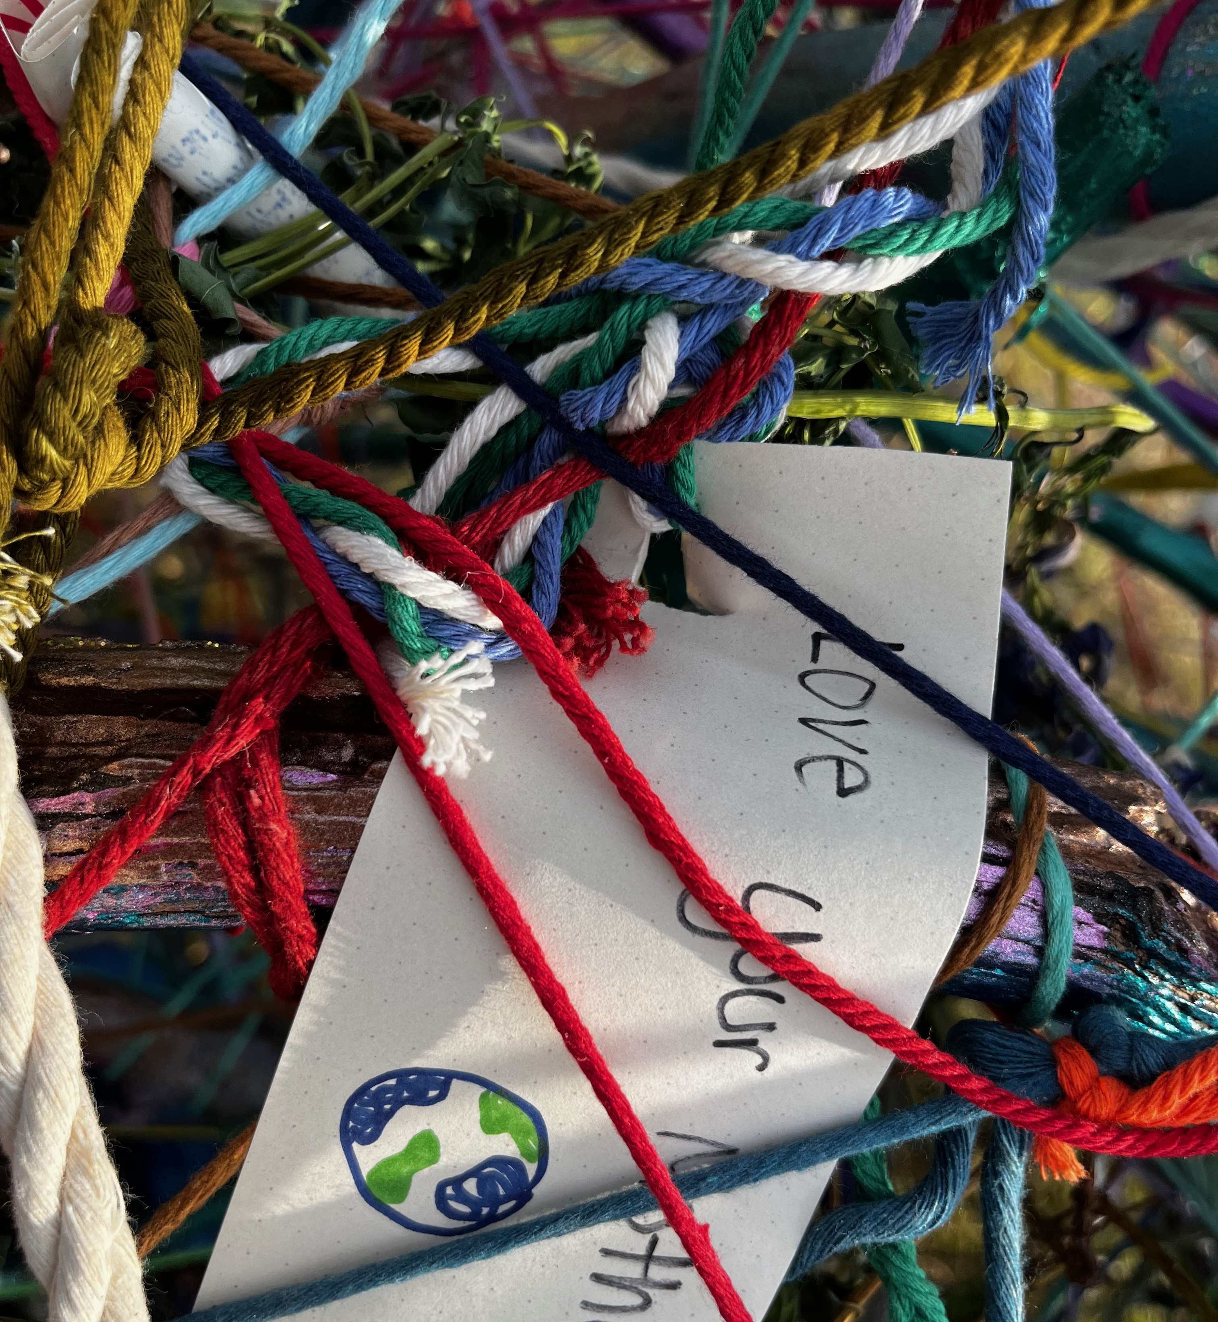

Slide 23
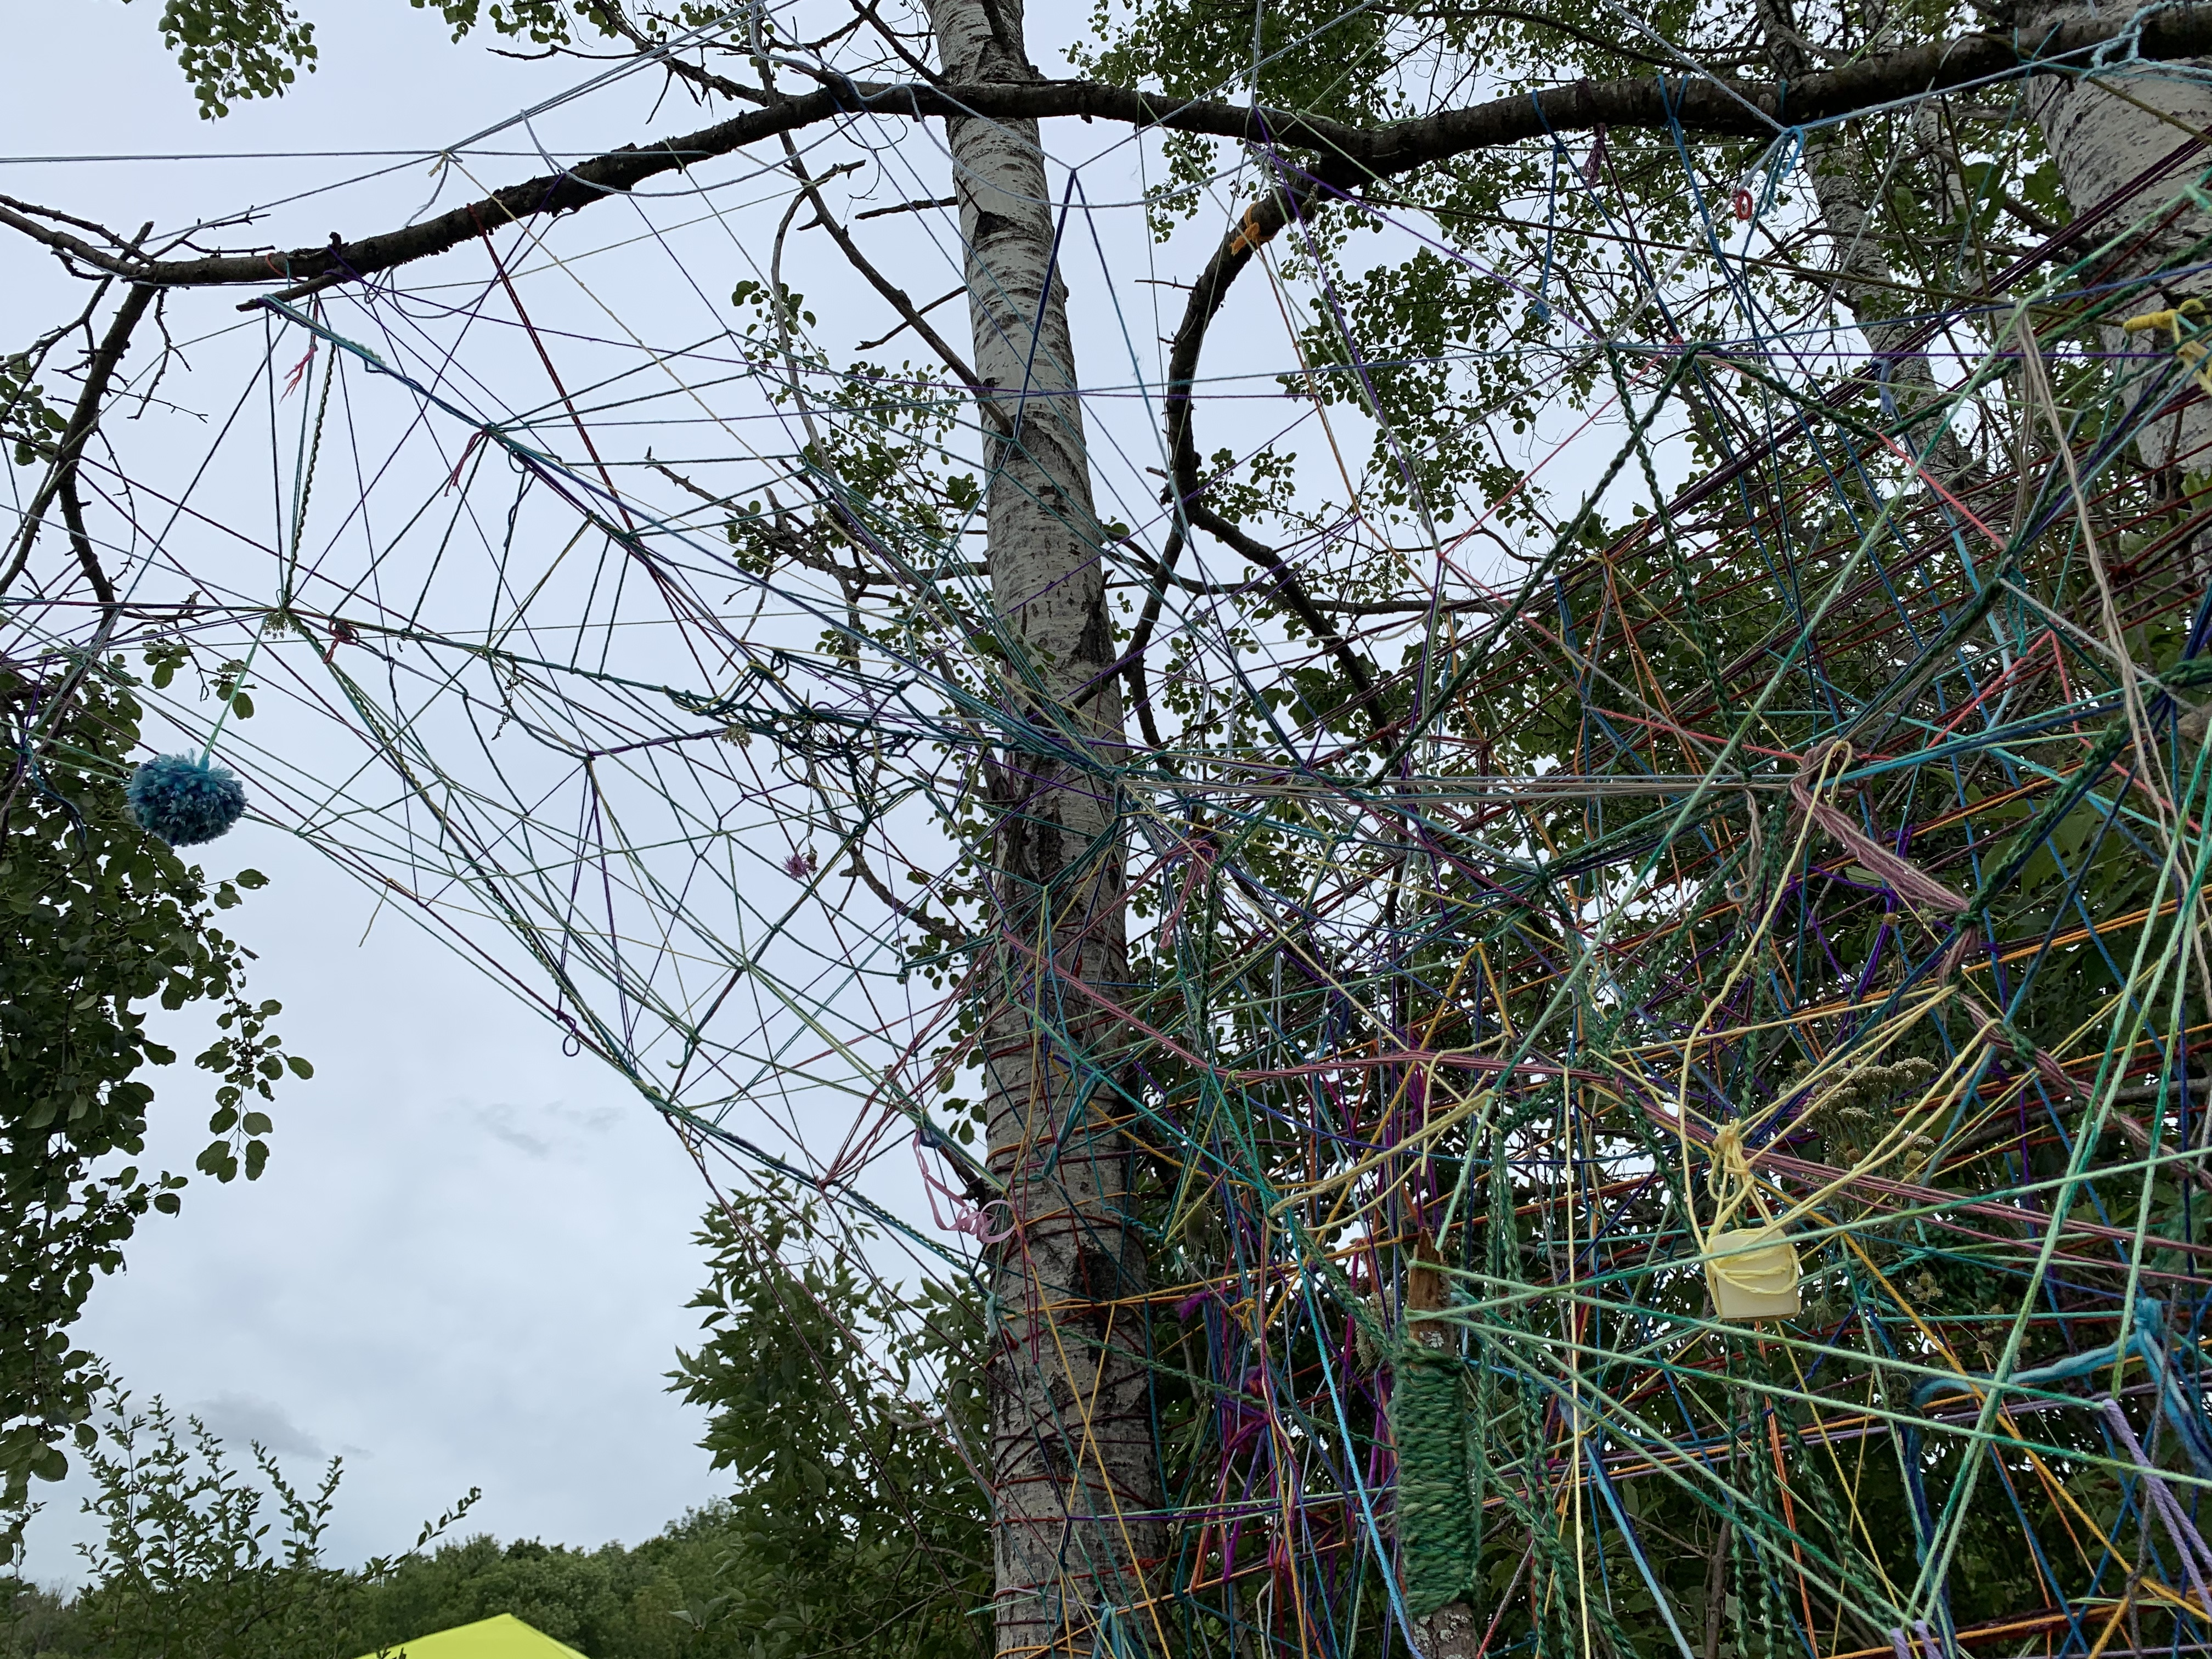
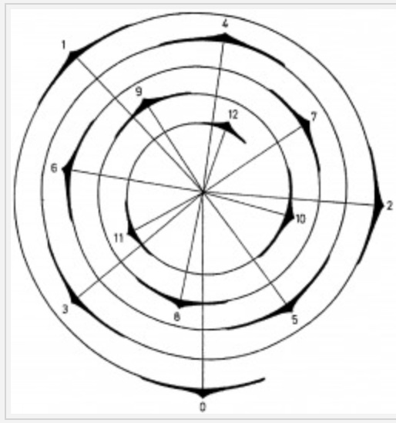

Slide 25
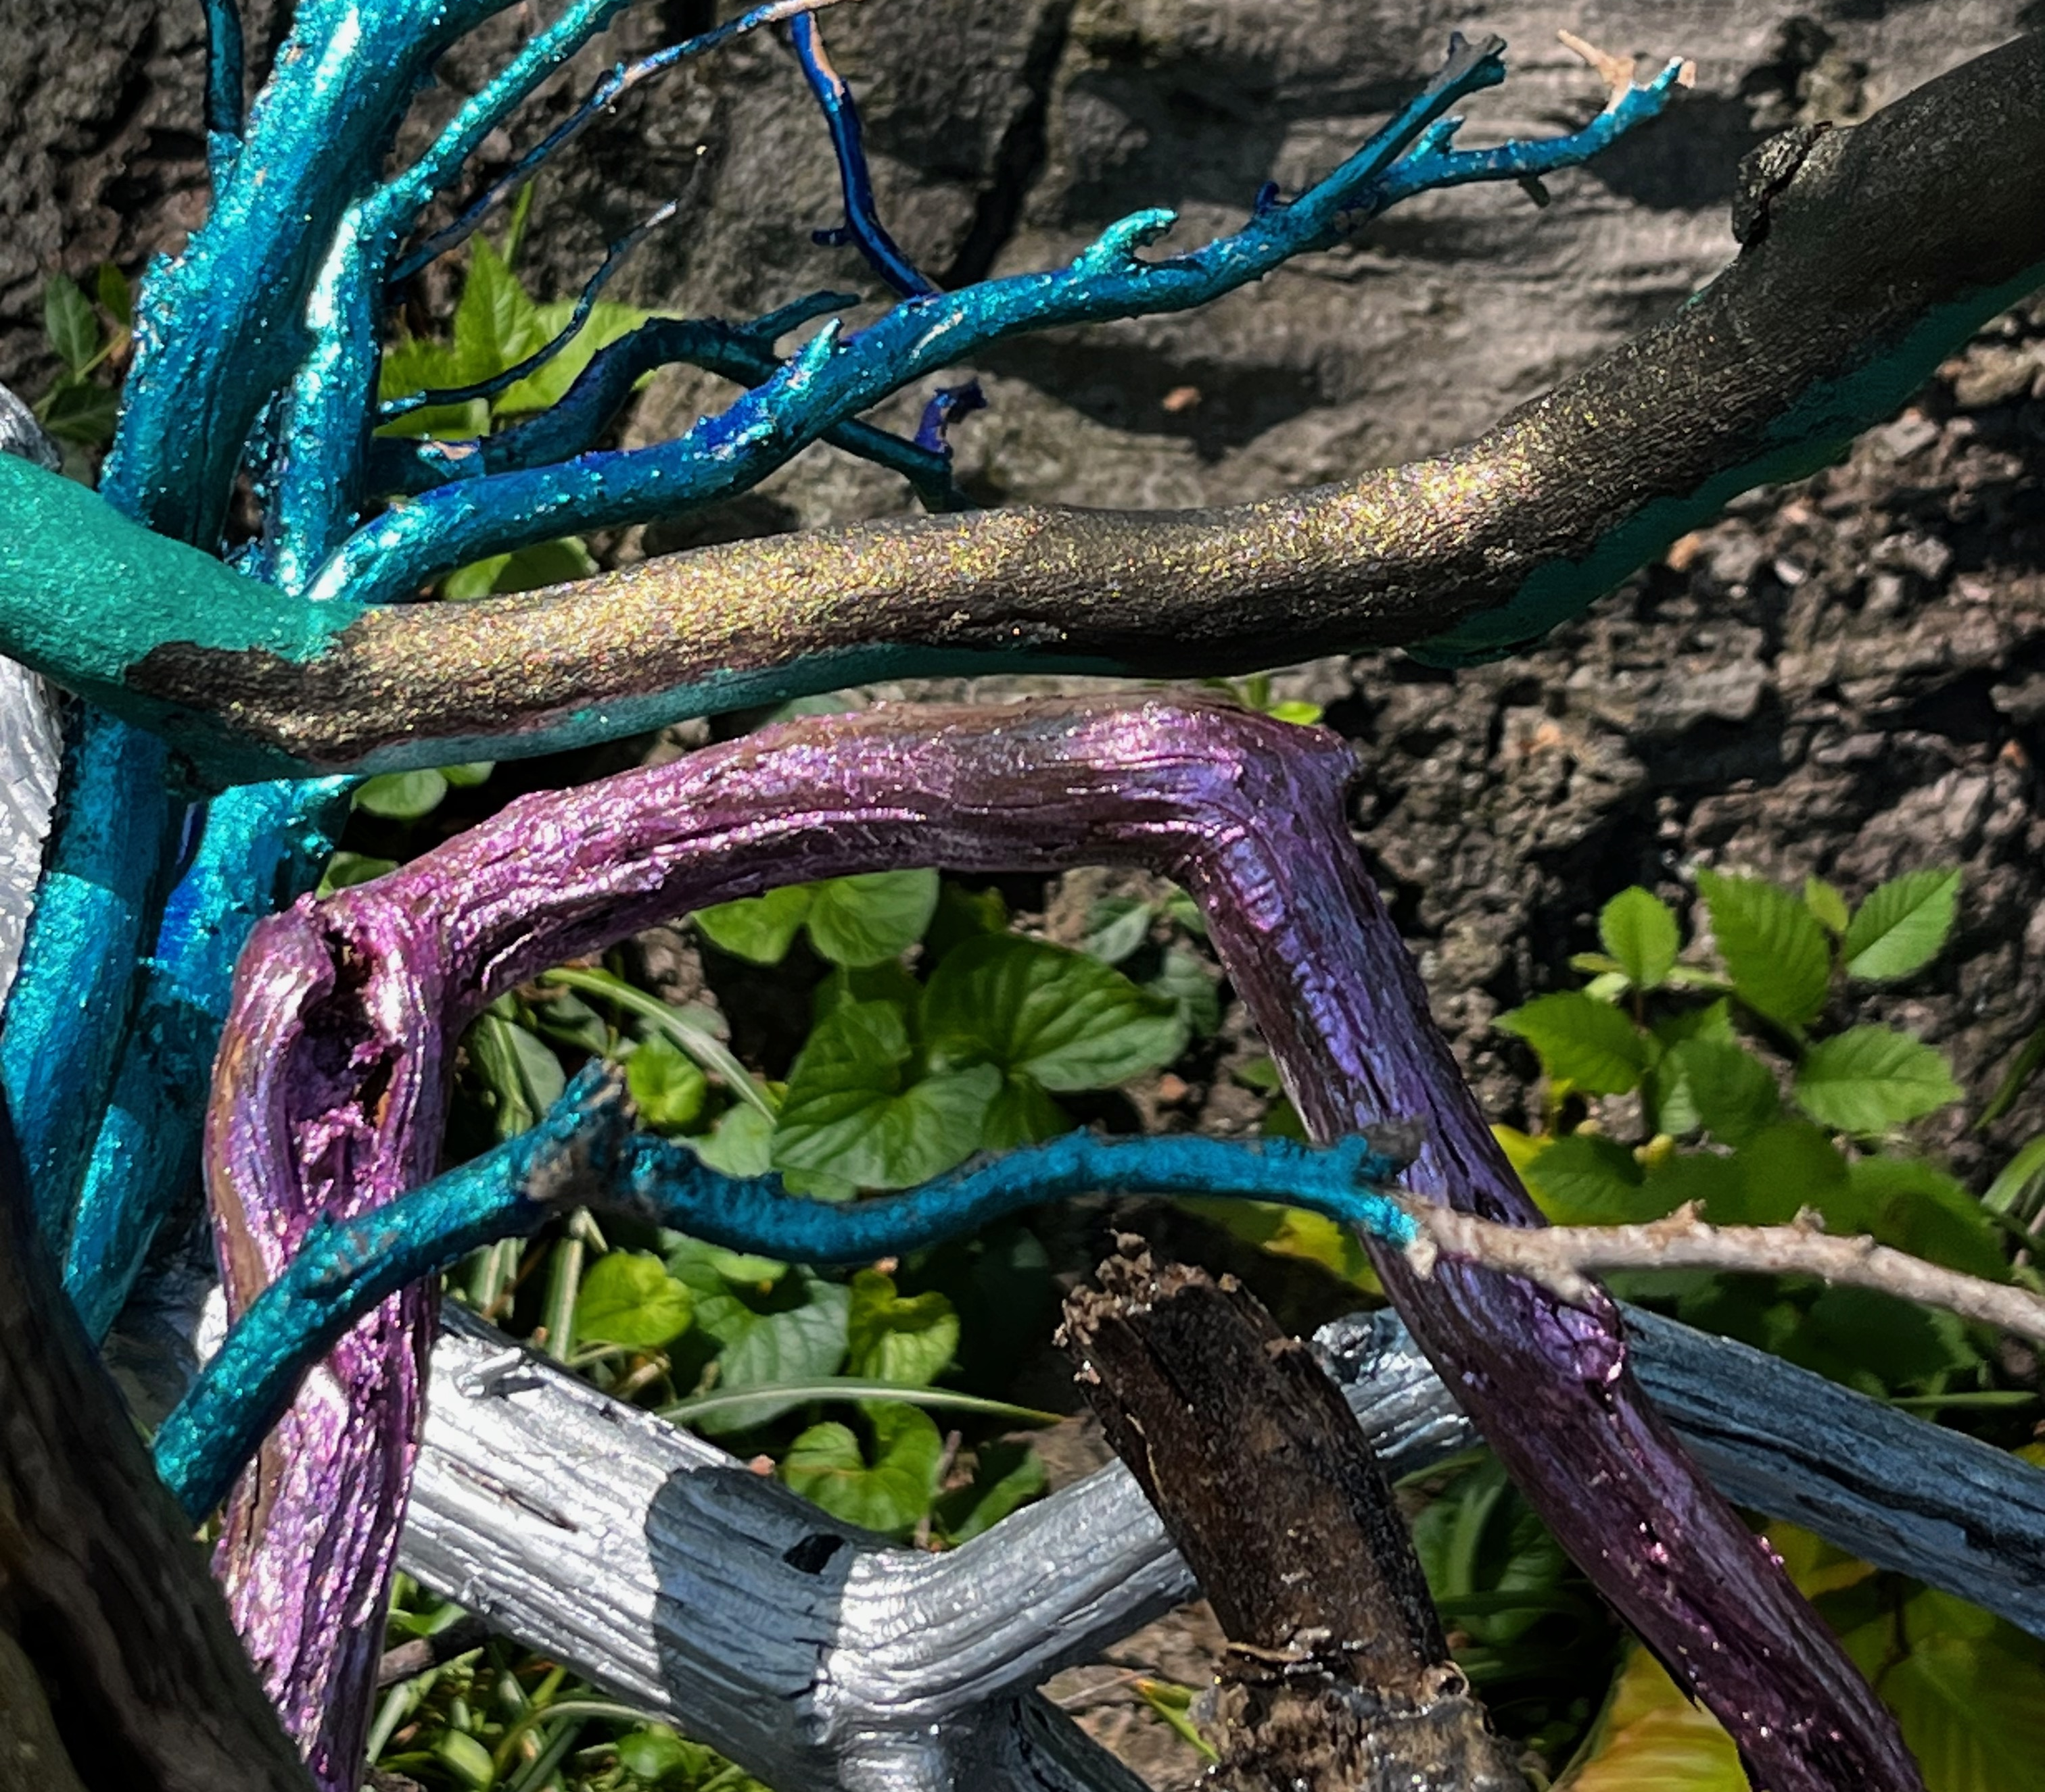
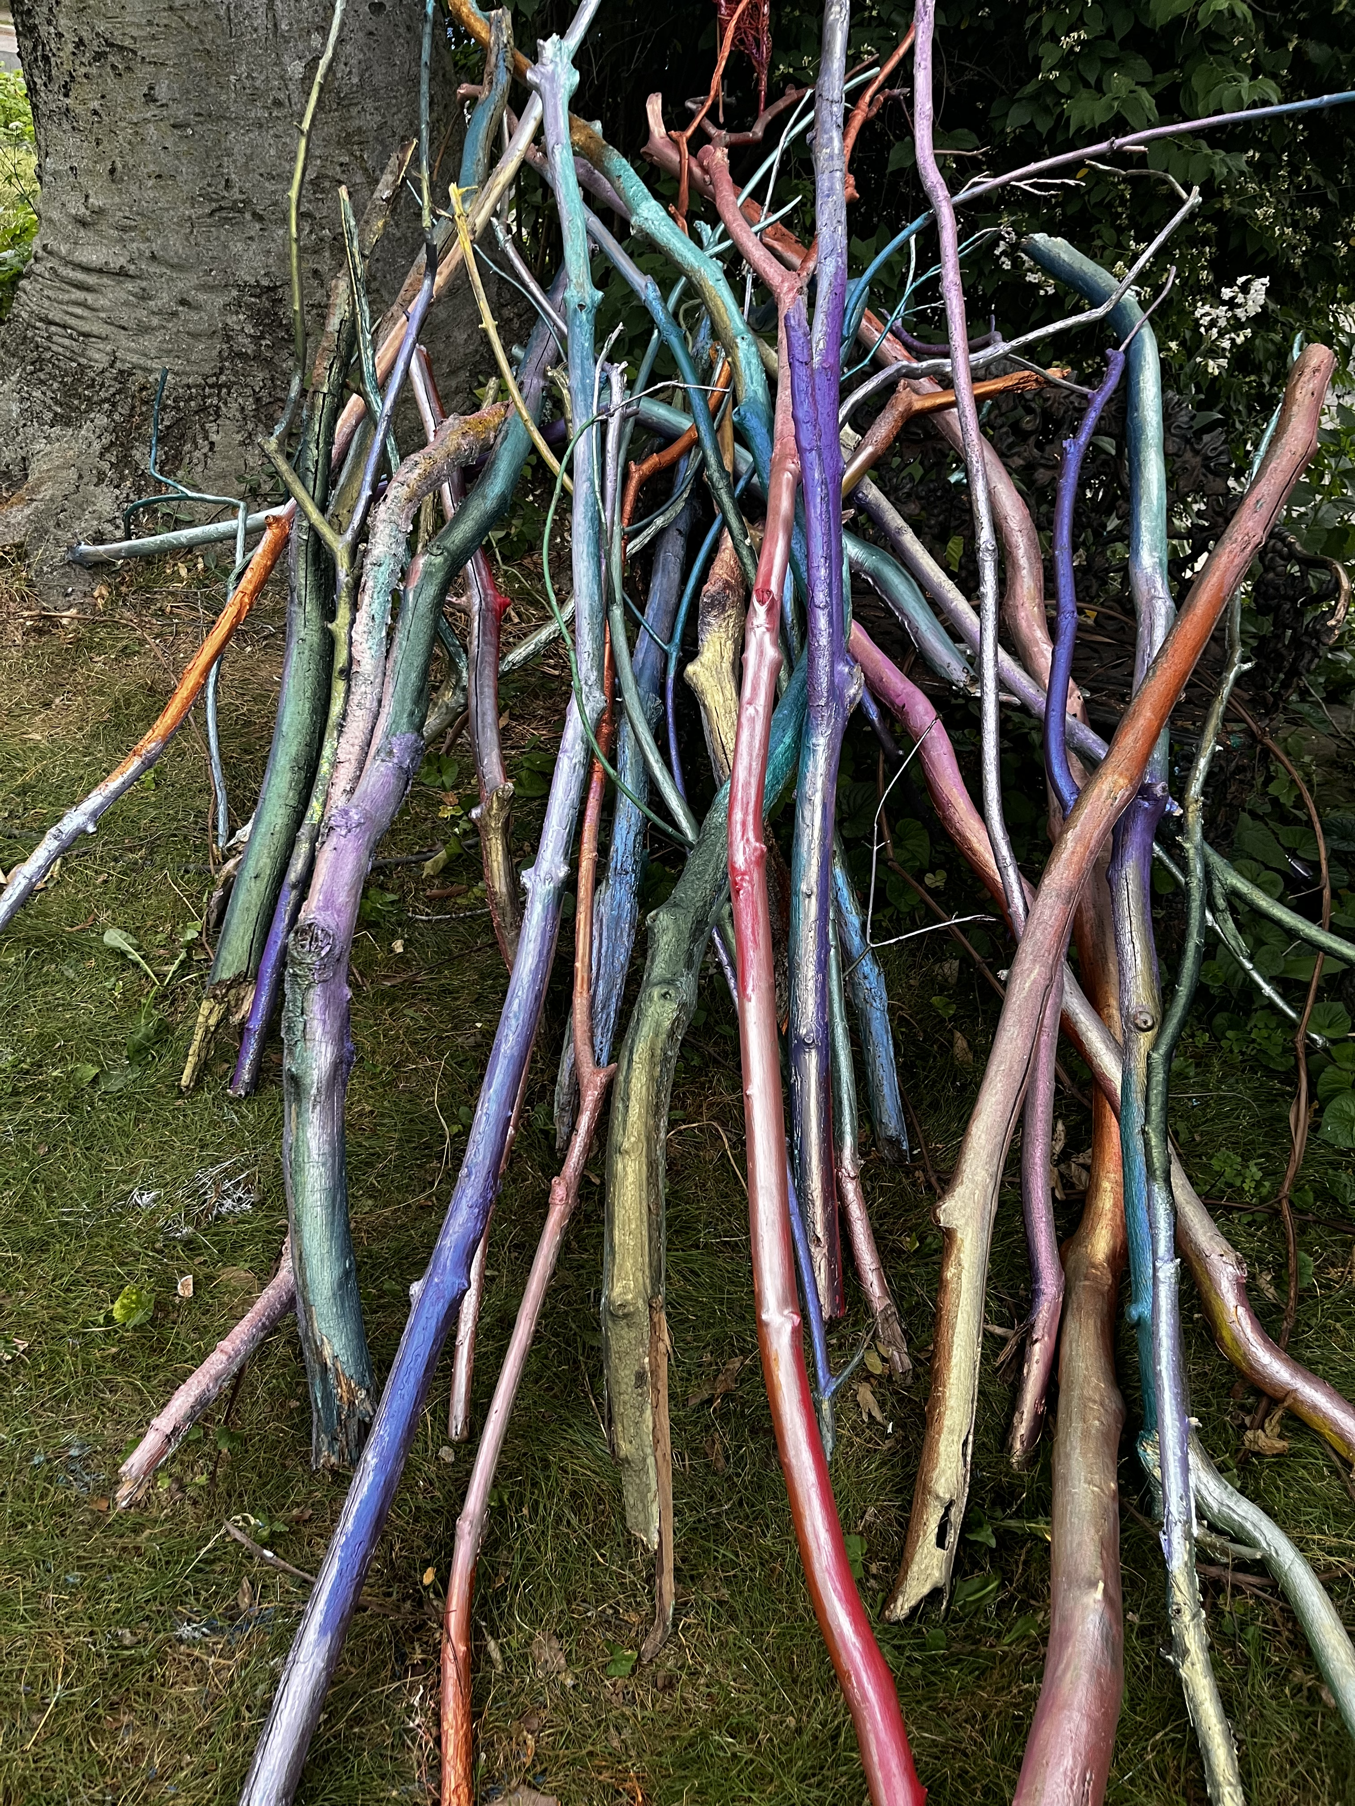

Slide 26
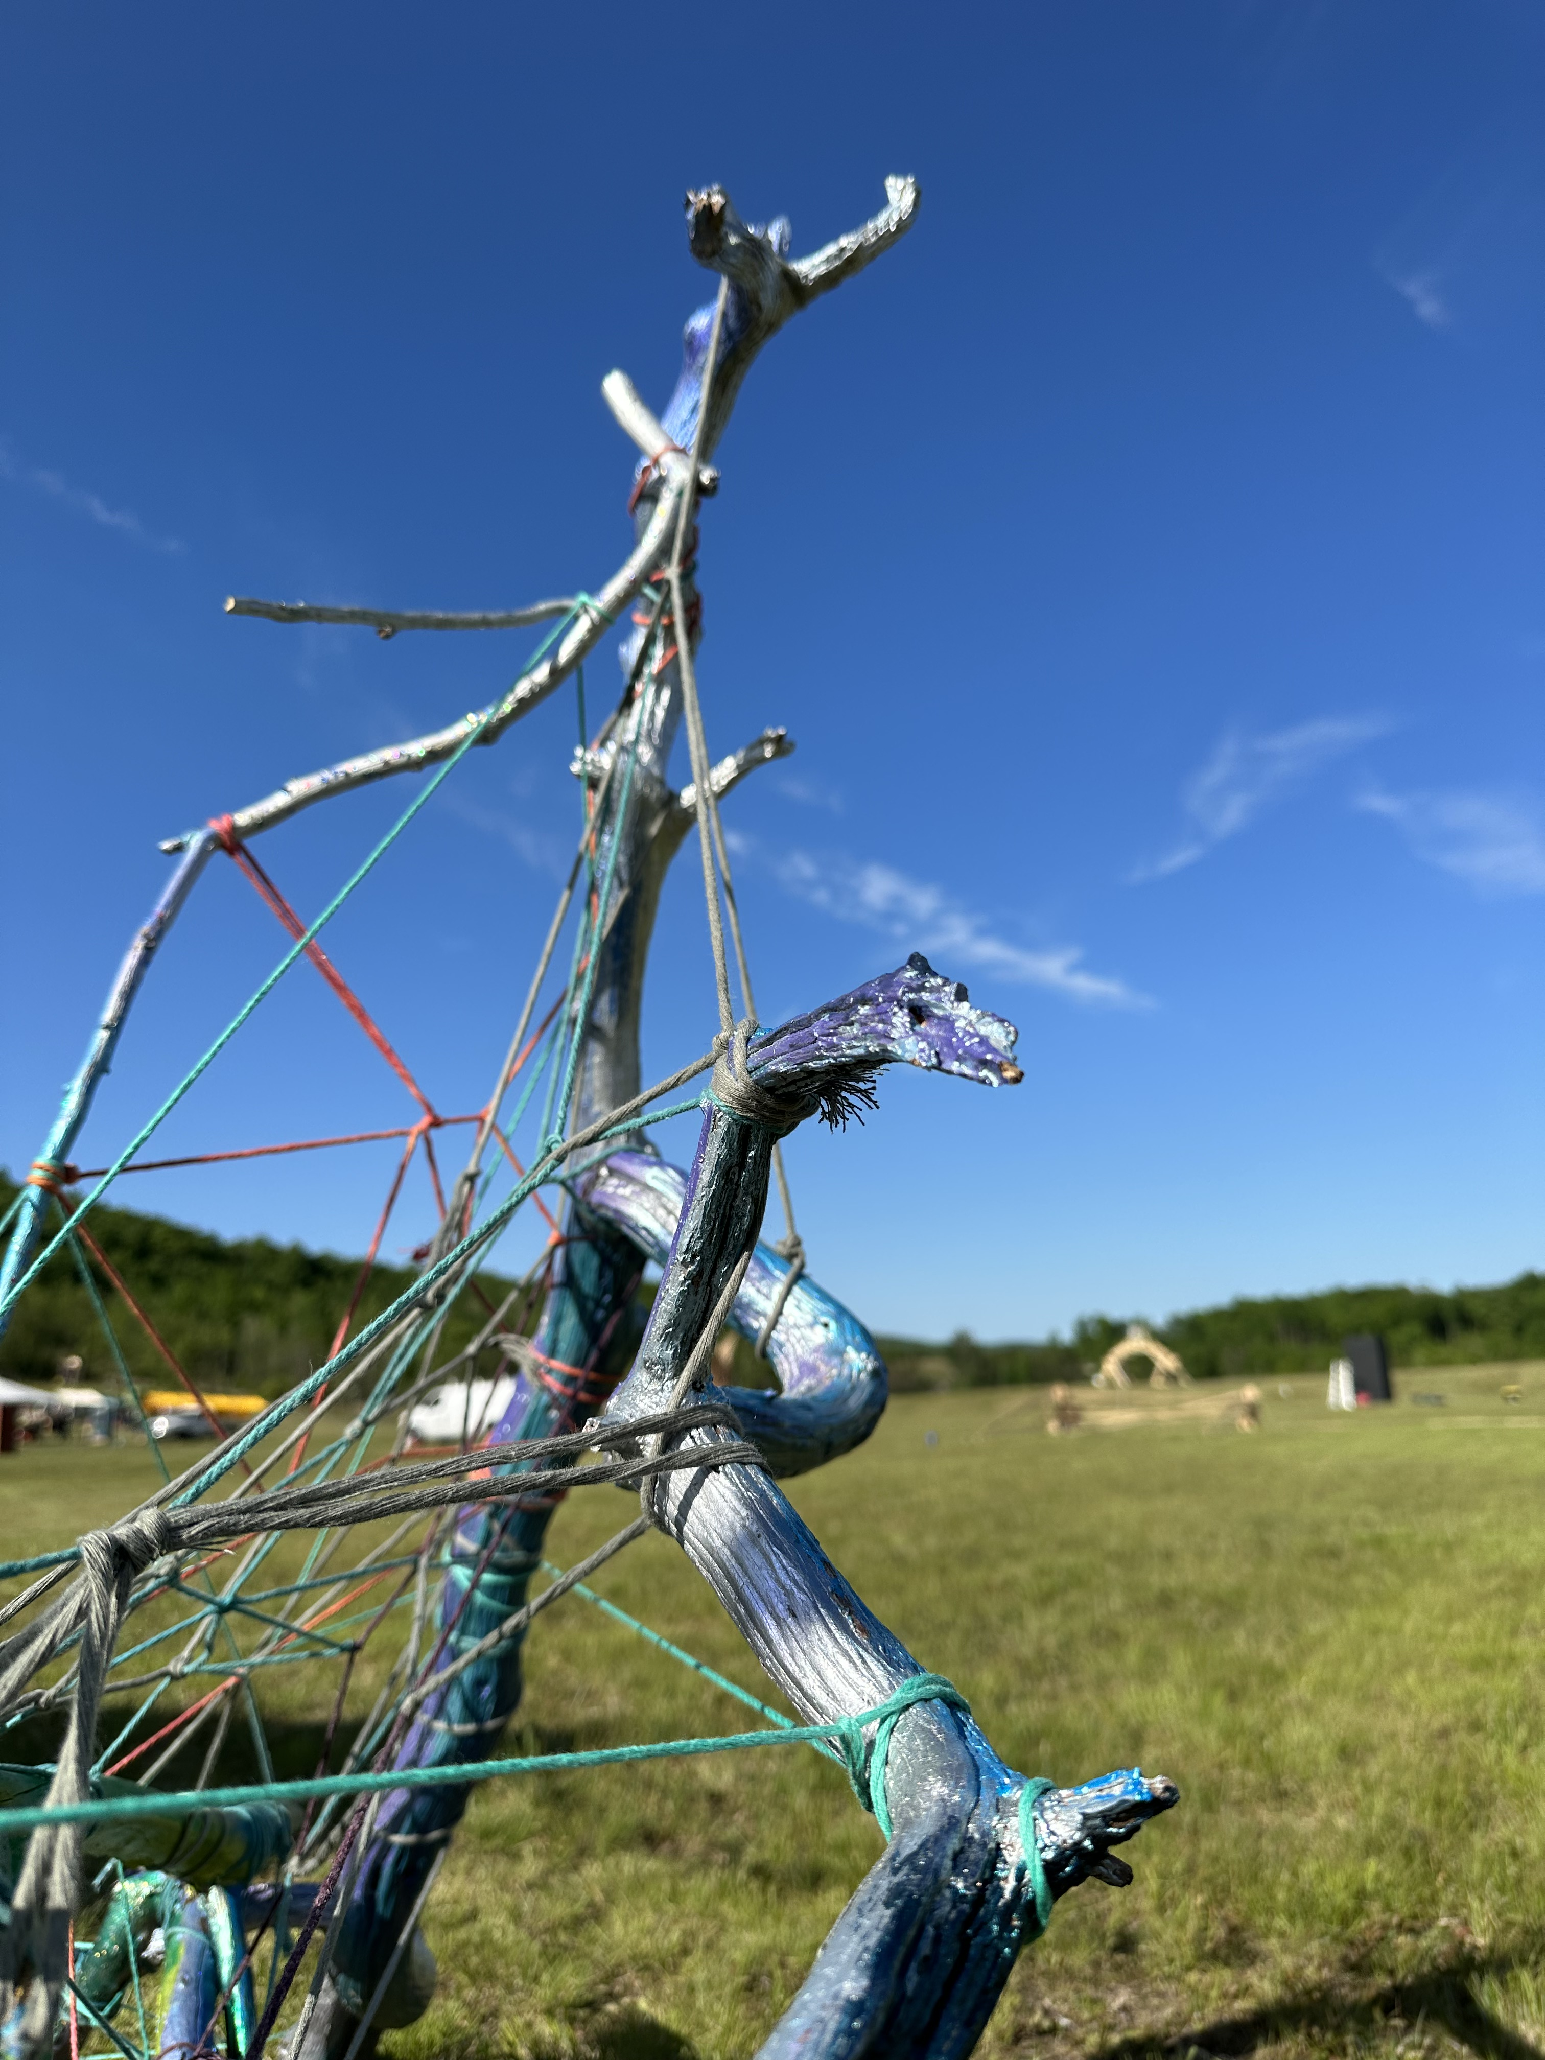
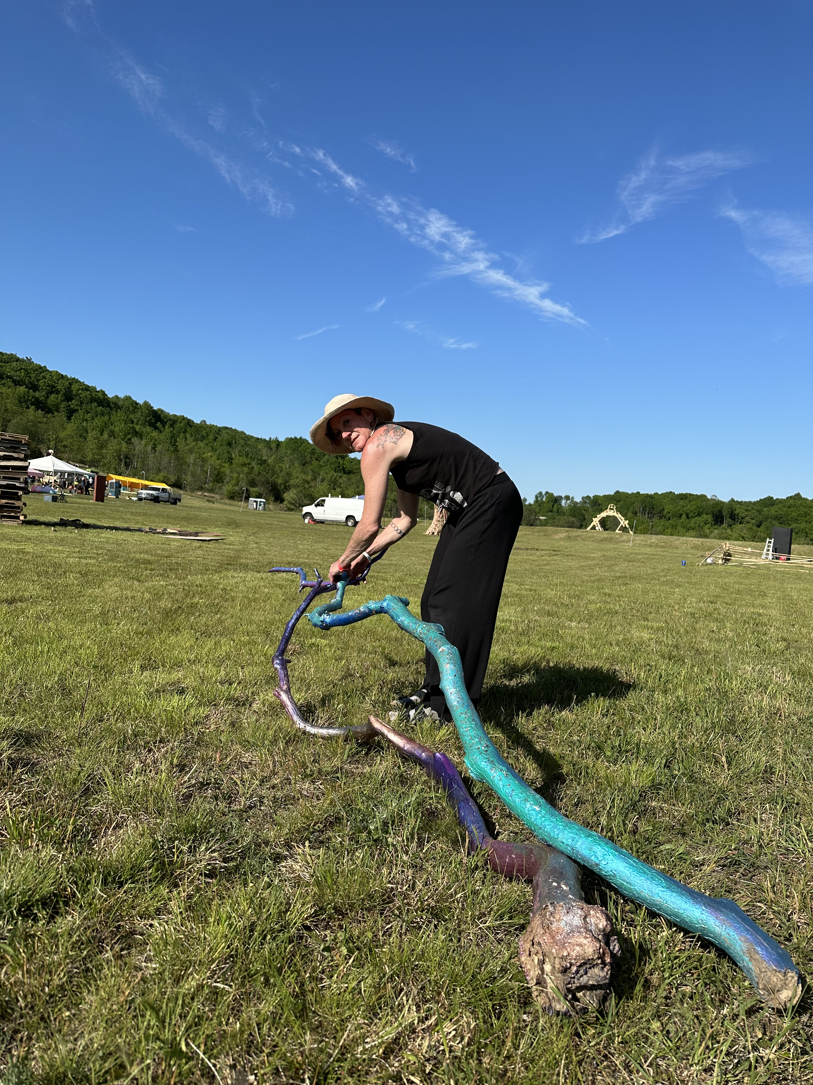

Slide 27
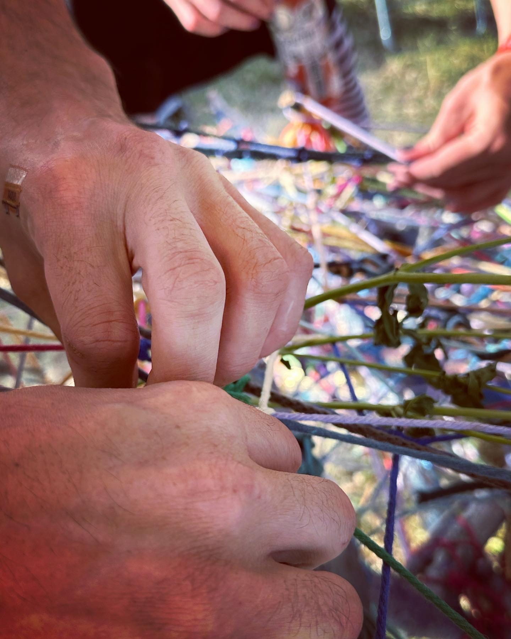
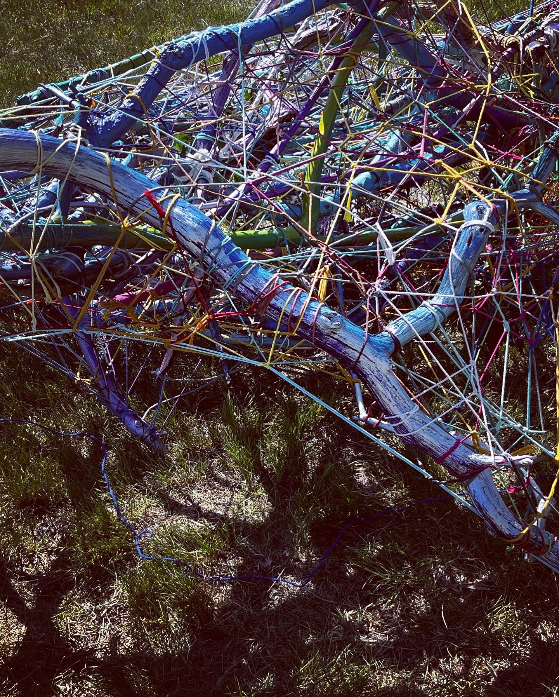

Slide 28
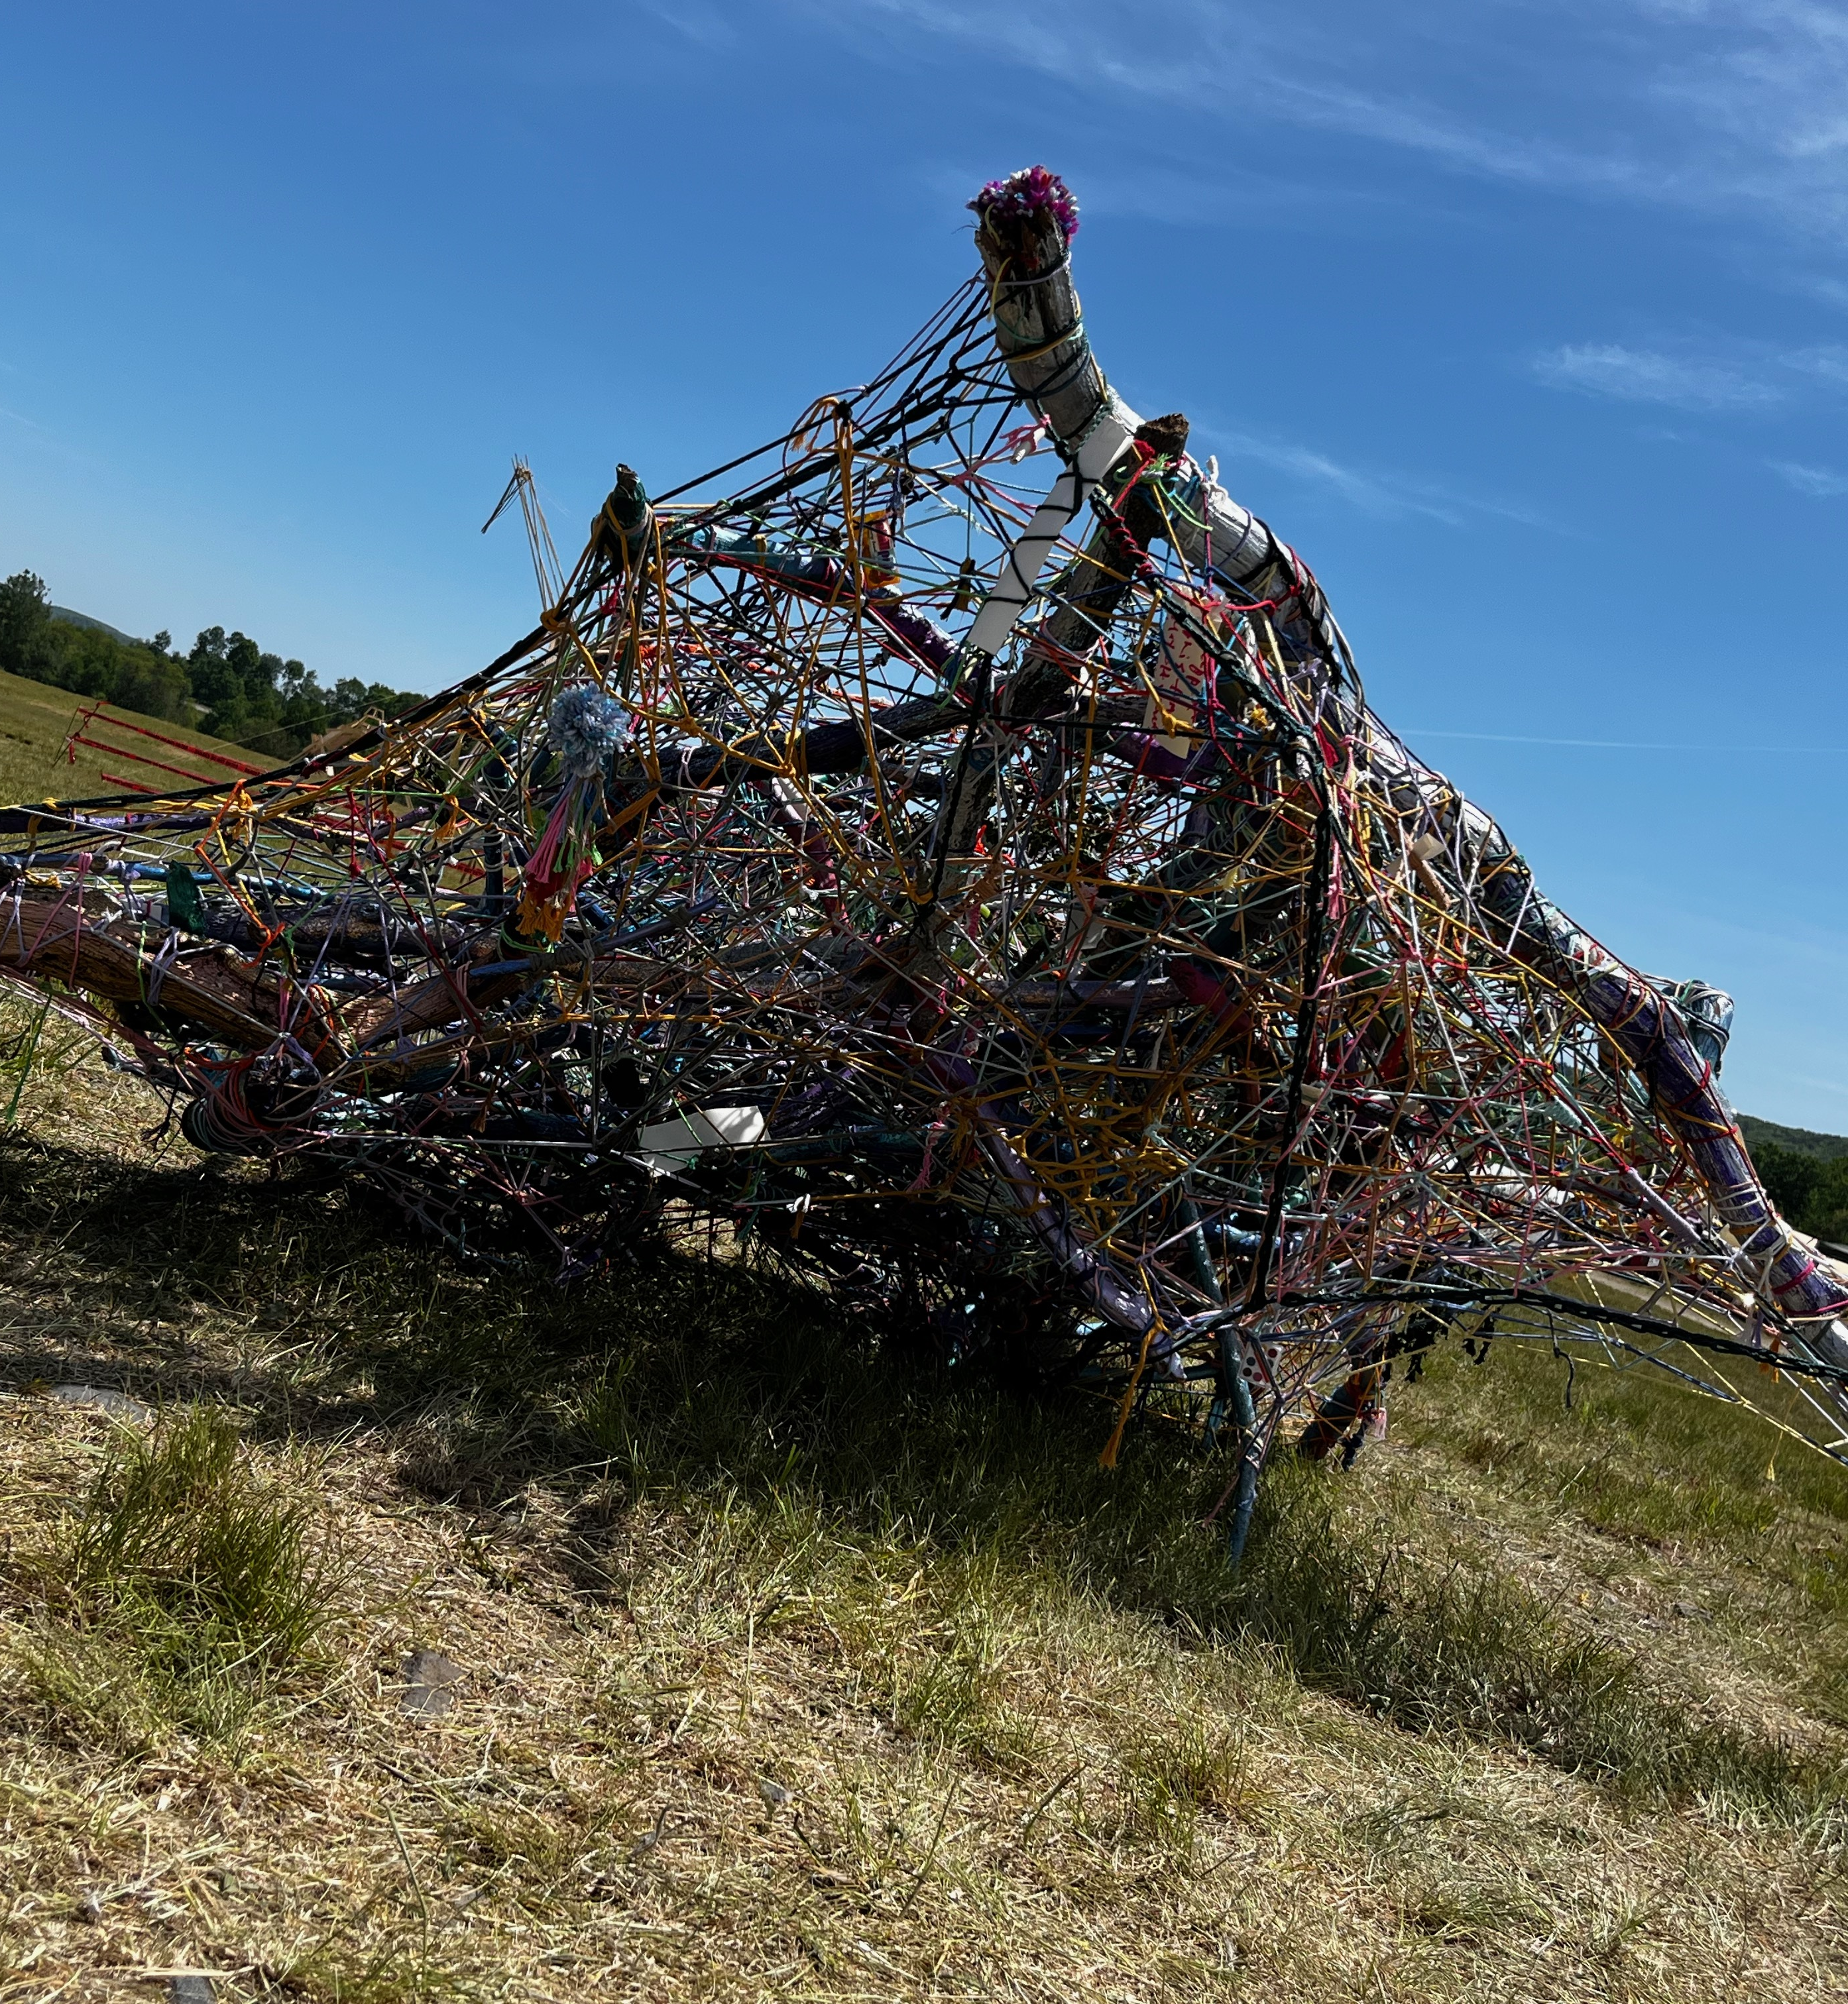
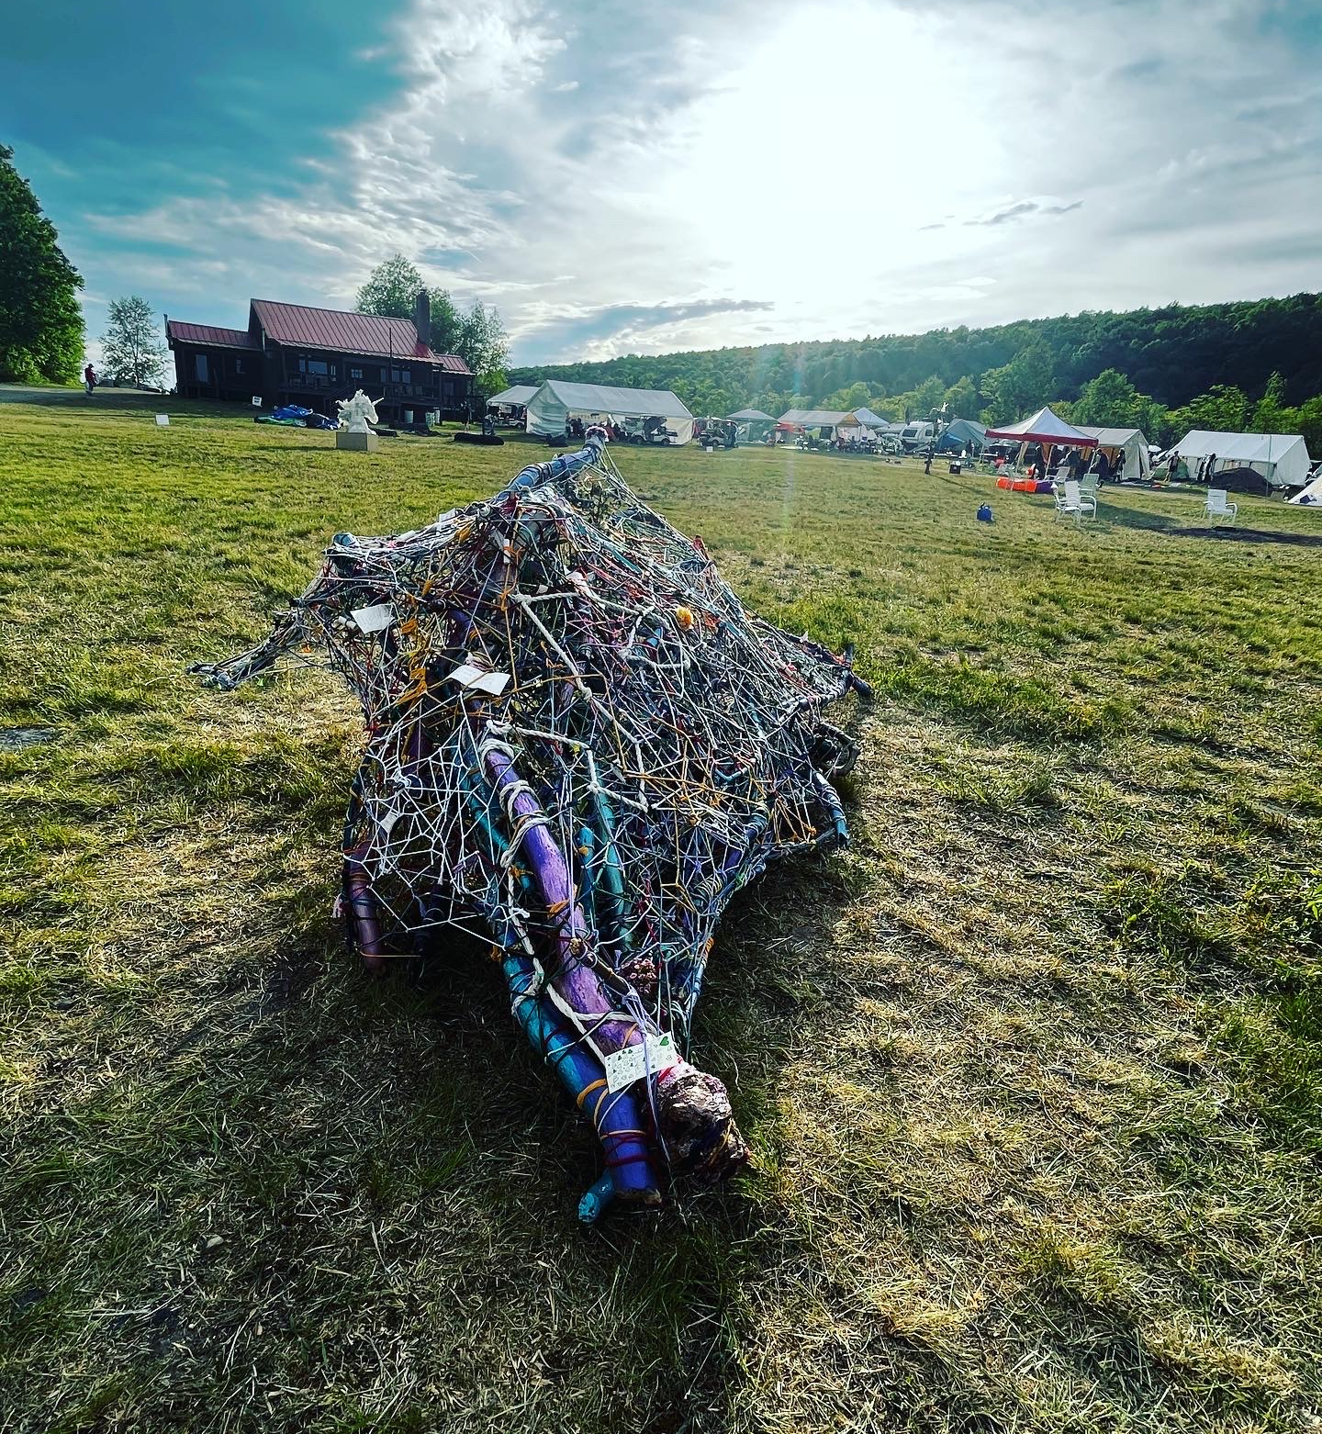

Slide 29
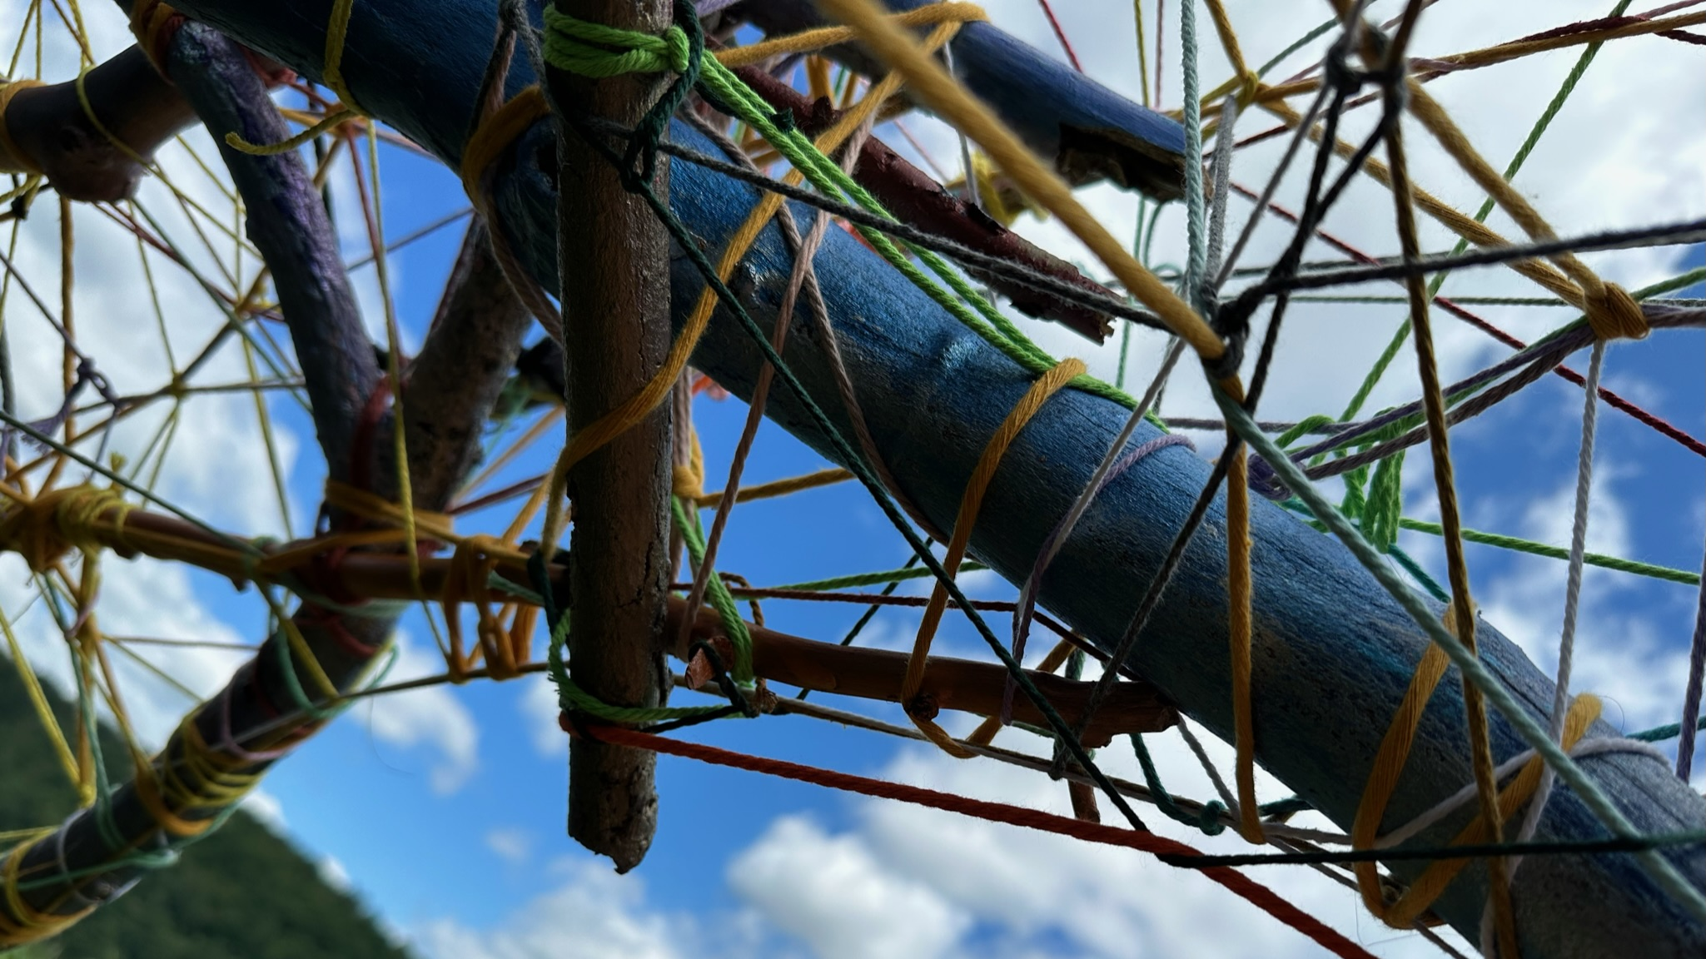

Slide 30
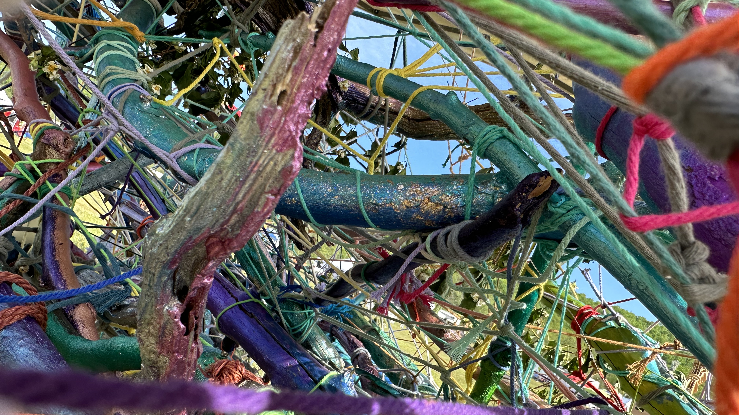

Slide 34
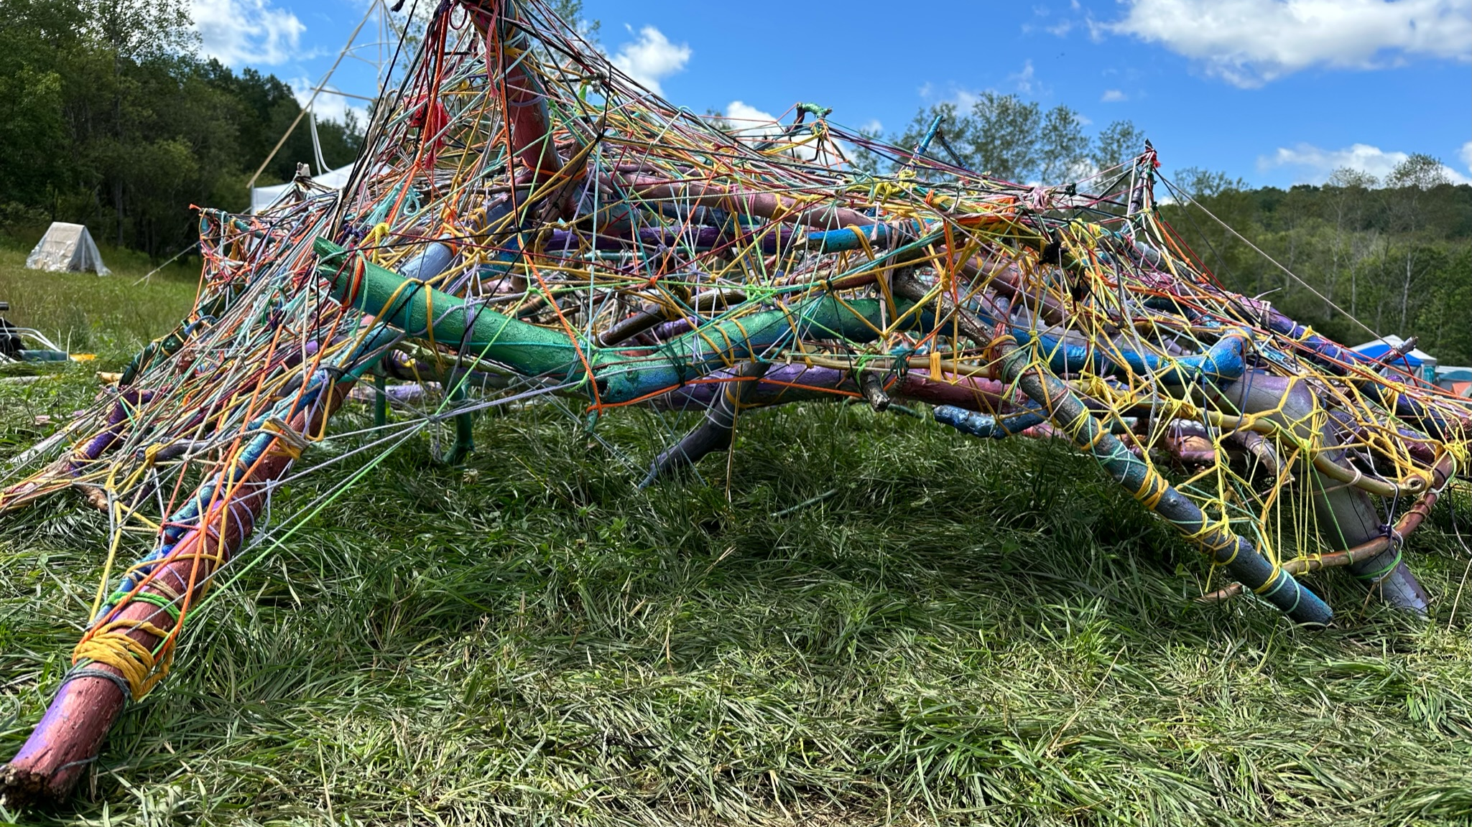

Slide 35
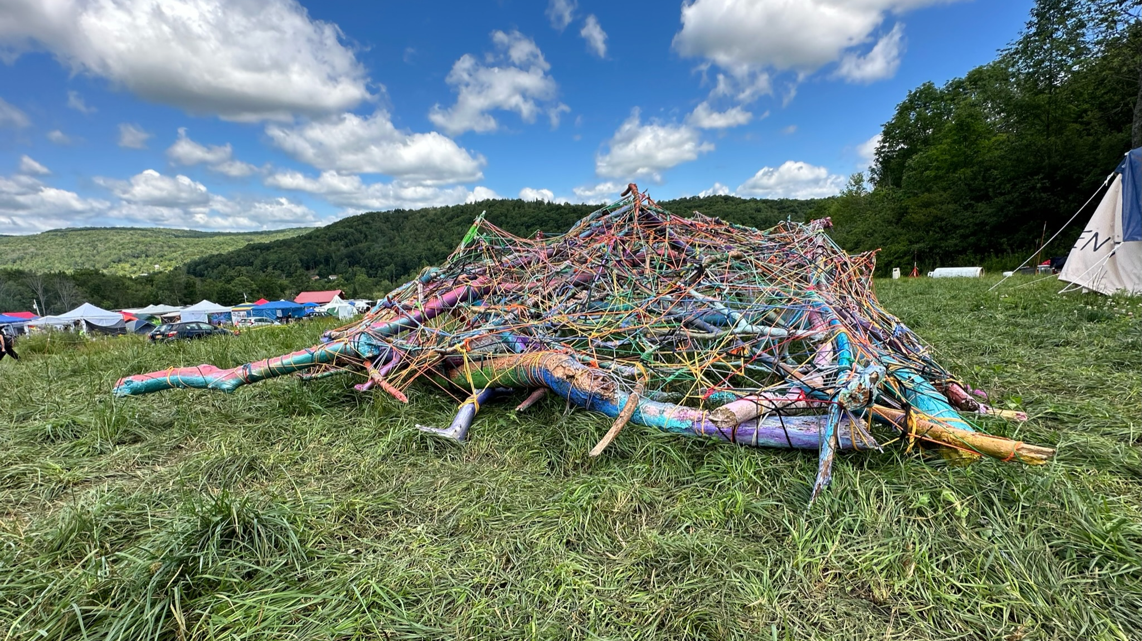

Slide 36
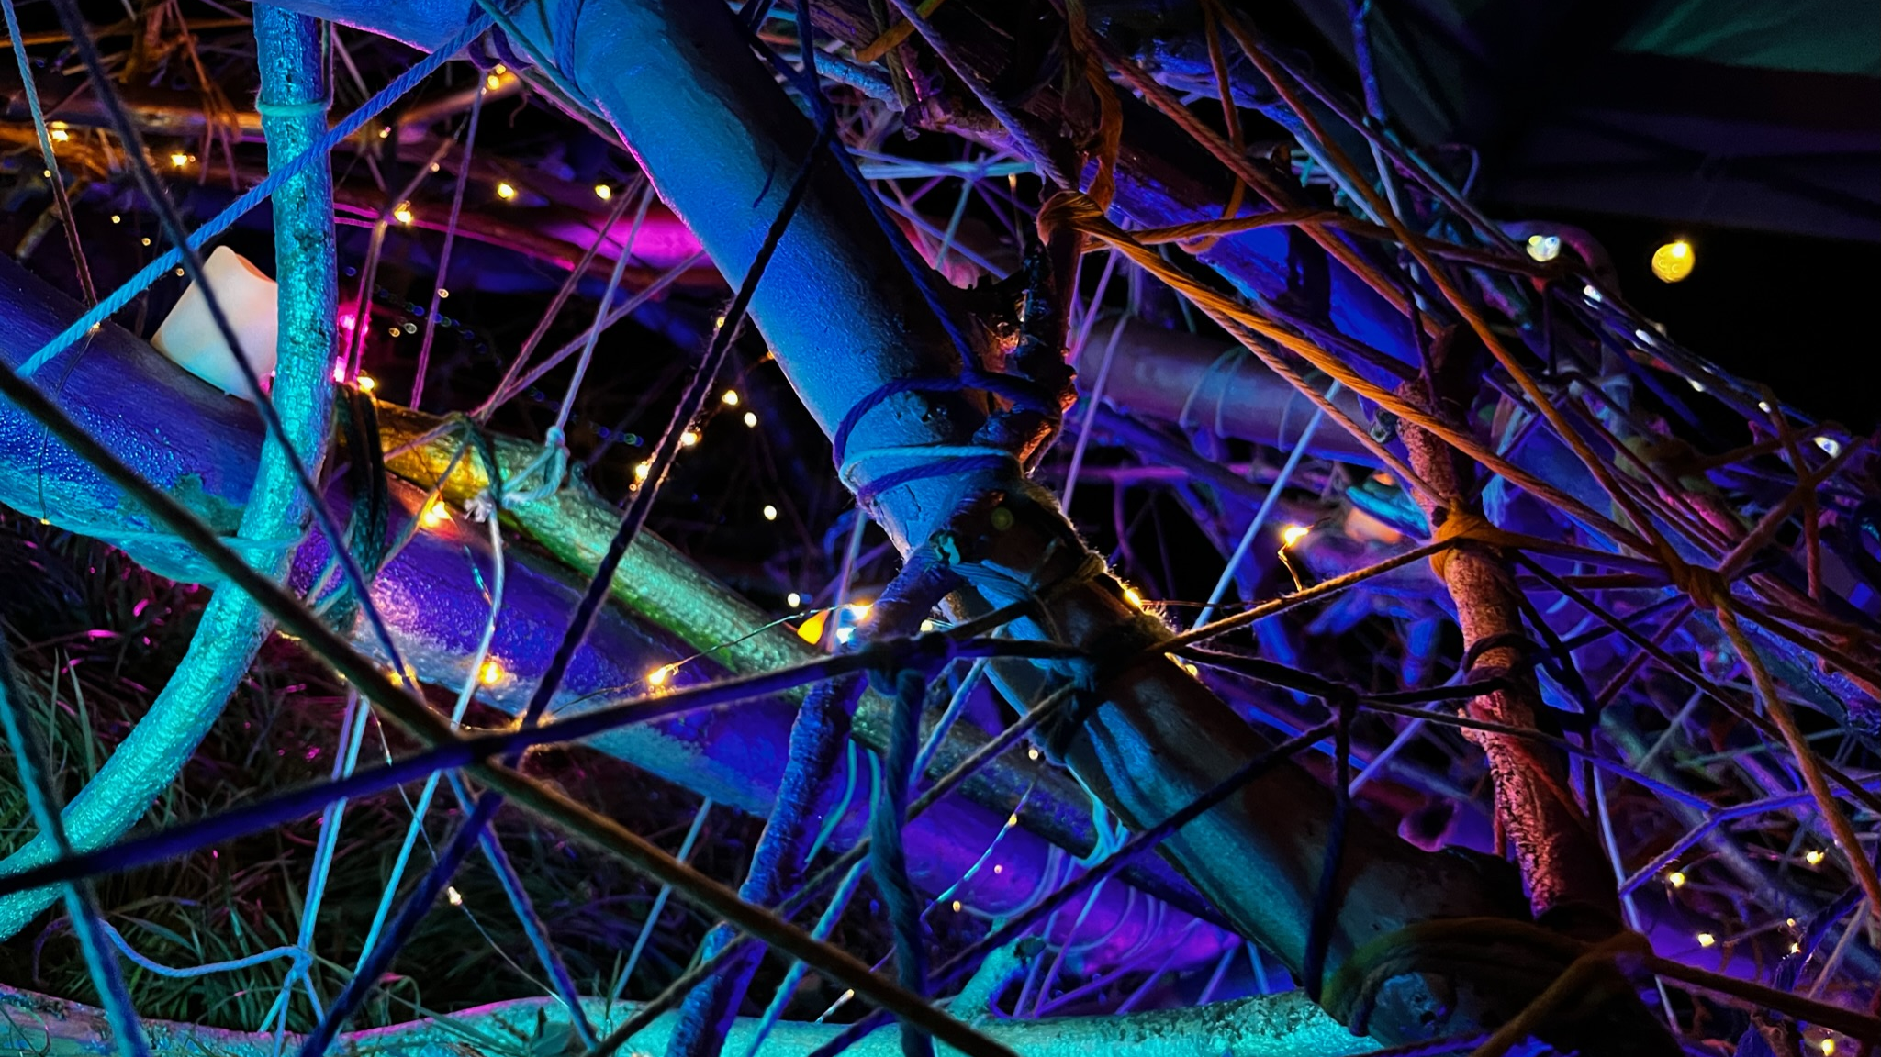

Slide 37
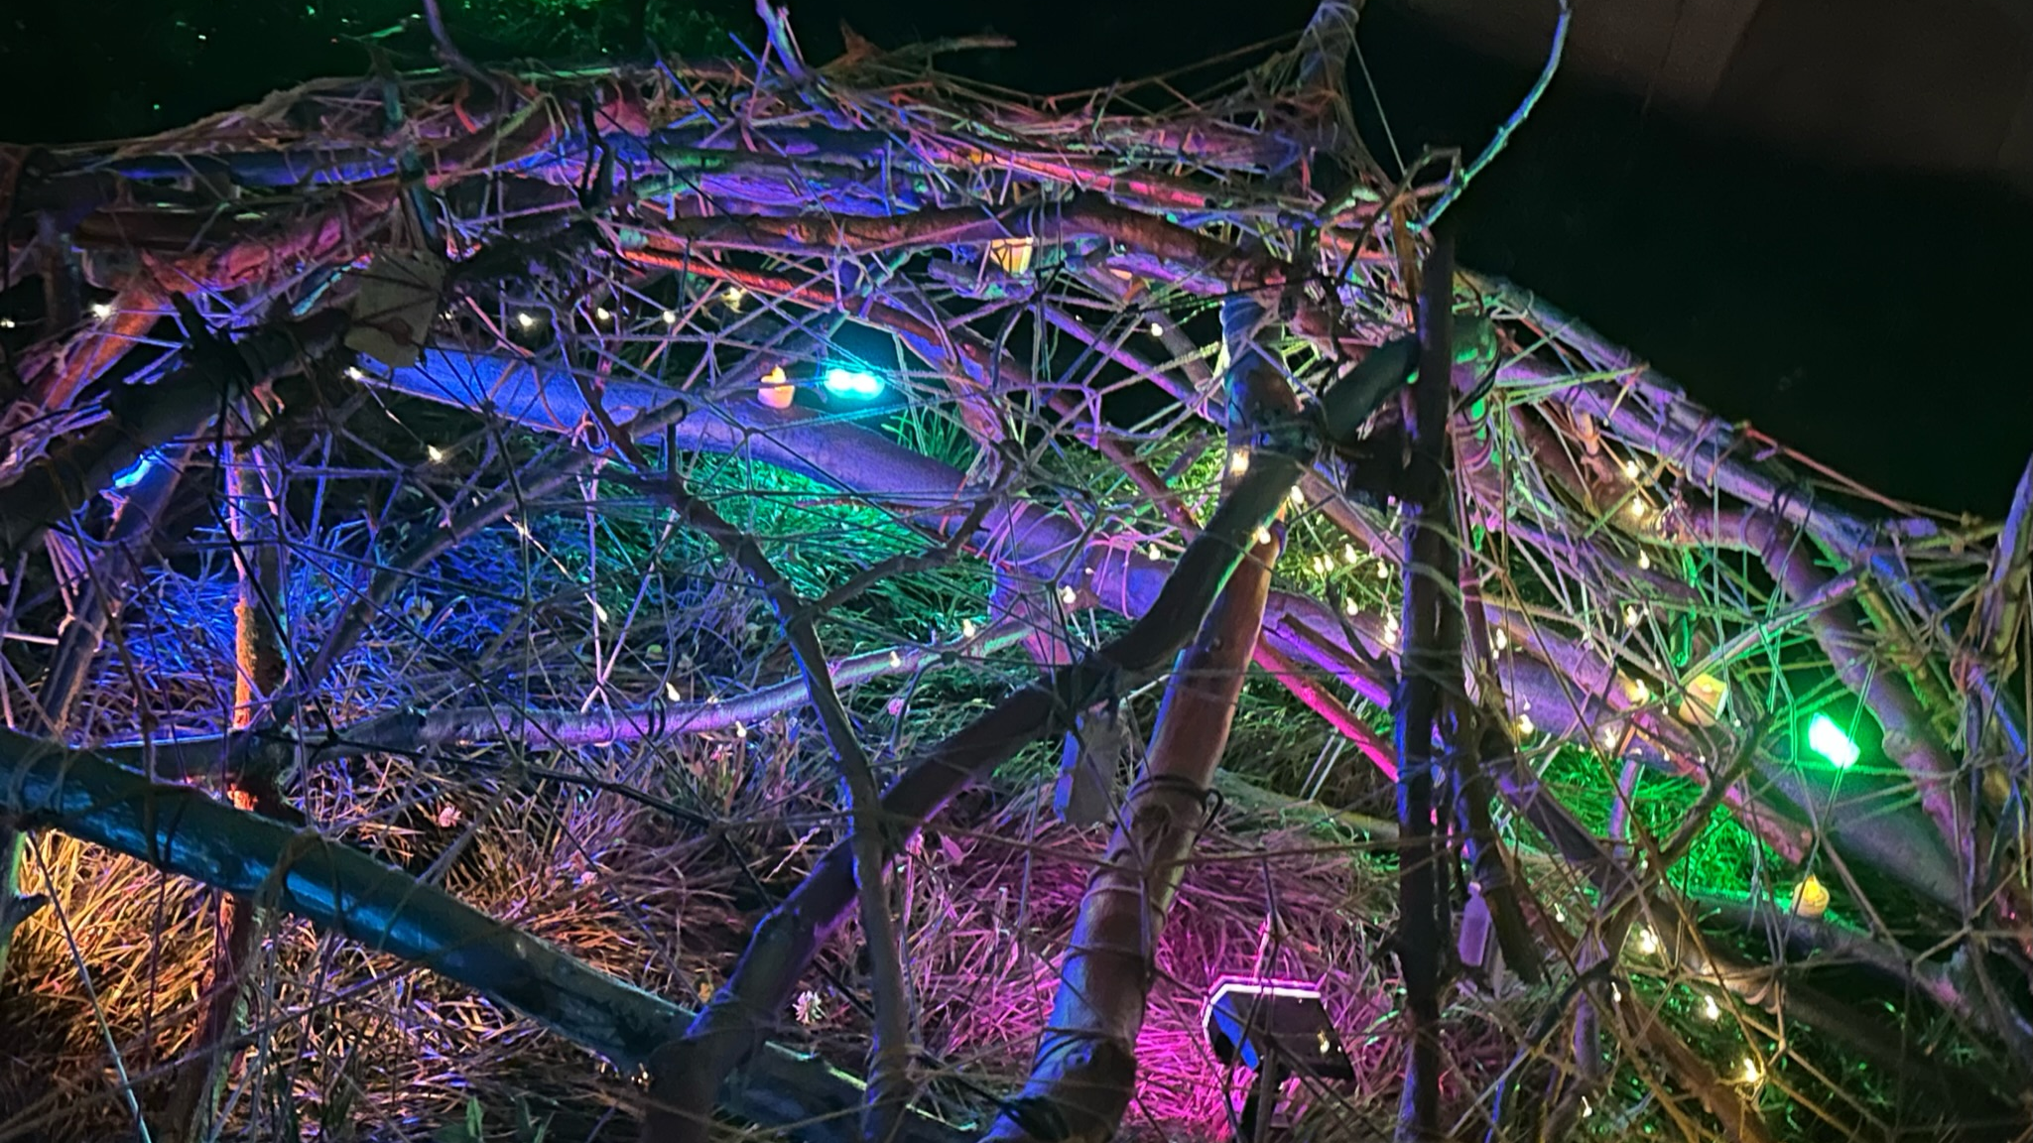

Slide 38
